Slide 1
Topic: Water scarcity Date: 19/02/2024
Do now:
How long can we live without water?
About 3 days
Copy the Success Criteria
Learning intentions: Understand the pressures placed on surface water and ground water and the relevance of this in maintaining food security.
Success criteria : Describe and explain the various pressures placed on water

Slide 2
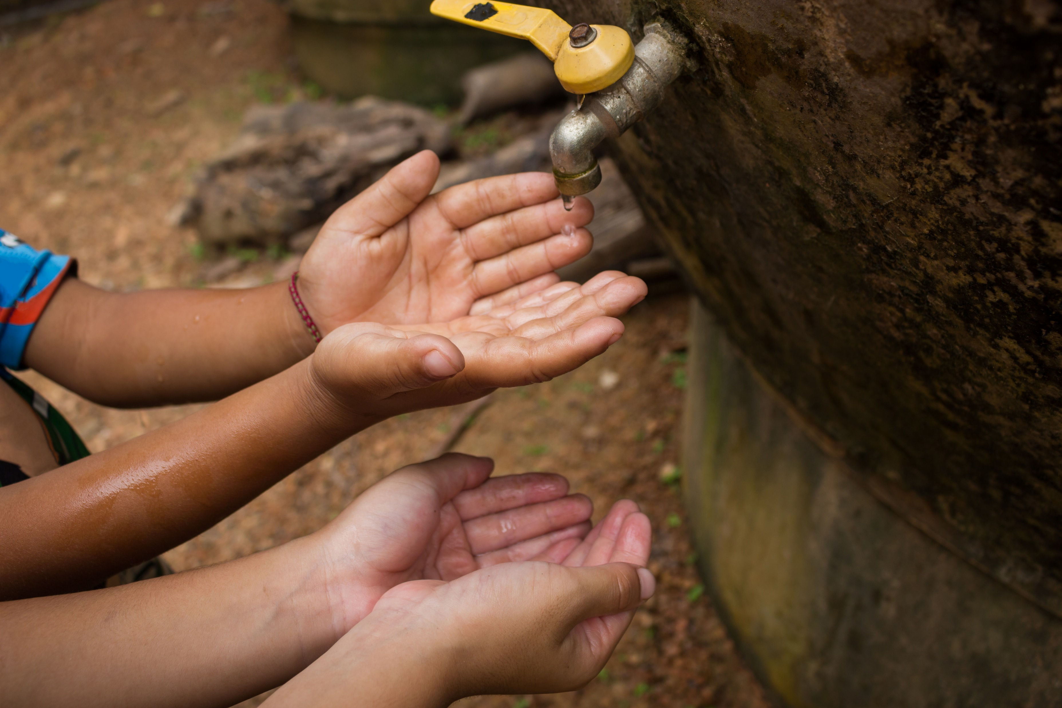
Water Shortages
Key Understandings
Approximately 1.1 billion people have no access to clean, reliable water.
4 billion people suffer from severe water scarcity for at least 1 month each year.
700 million people could be displaced due to water scarcity by 2030.
Although water scarcity can be caused by a physical lack of water through low rainfall, it is mainly due to economic factors. Governments can not afford to provide clean water for their citizens.
METACOGNITION CORNER
What do you already know about this topic?
How do you feel about this topic? (excited, anxious, curious, nervous)
How does this topic relate to something you already know?
What questions do you already have about this topic?
Notes:
Each resource includes:
Activate- a starter, an introduction, a stimulus
Content- The Geographical knowledge- supported by short activities, images, graphs, diagrams
Review- a plenary, recall activity, AFL, knowledge check
Useful links- to video clips, websites etc.
Font used: Google Quicksand: https://fonts.google.com/specimen/Quicksand

Slide 3
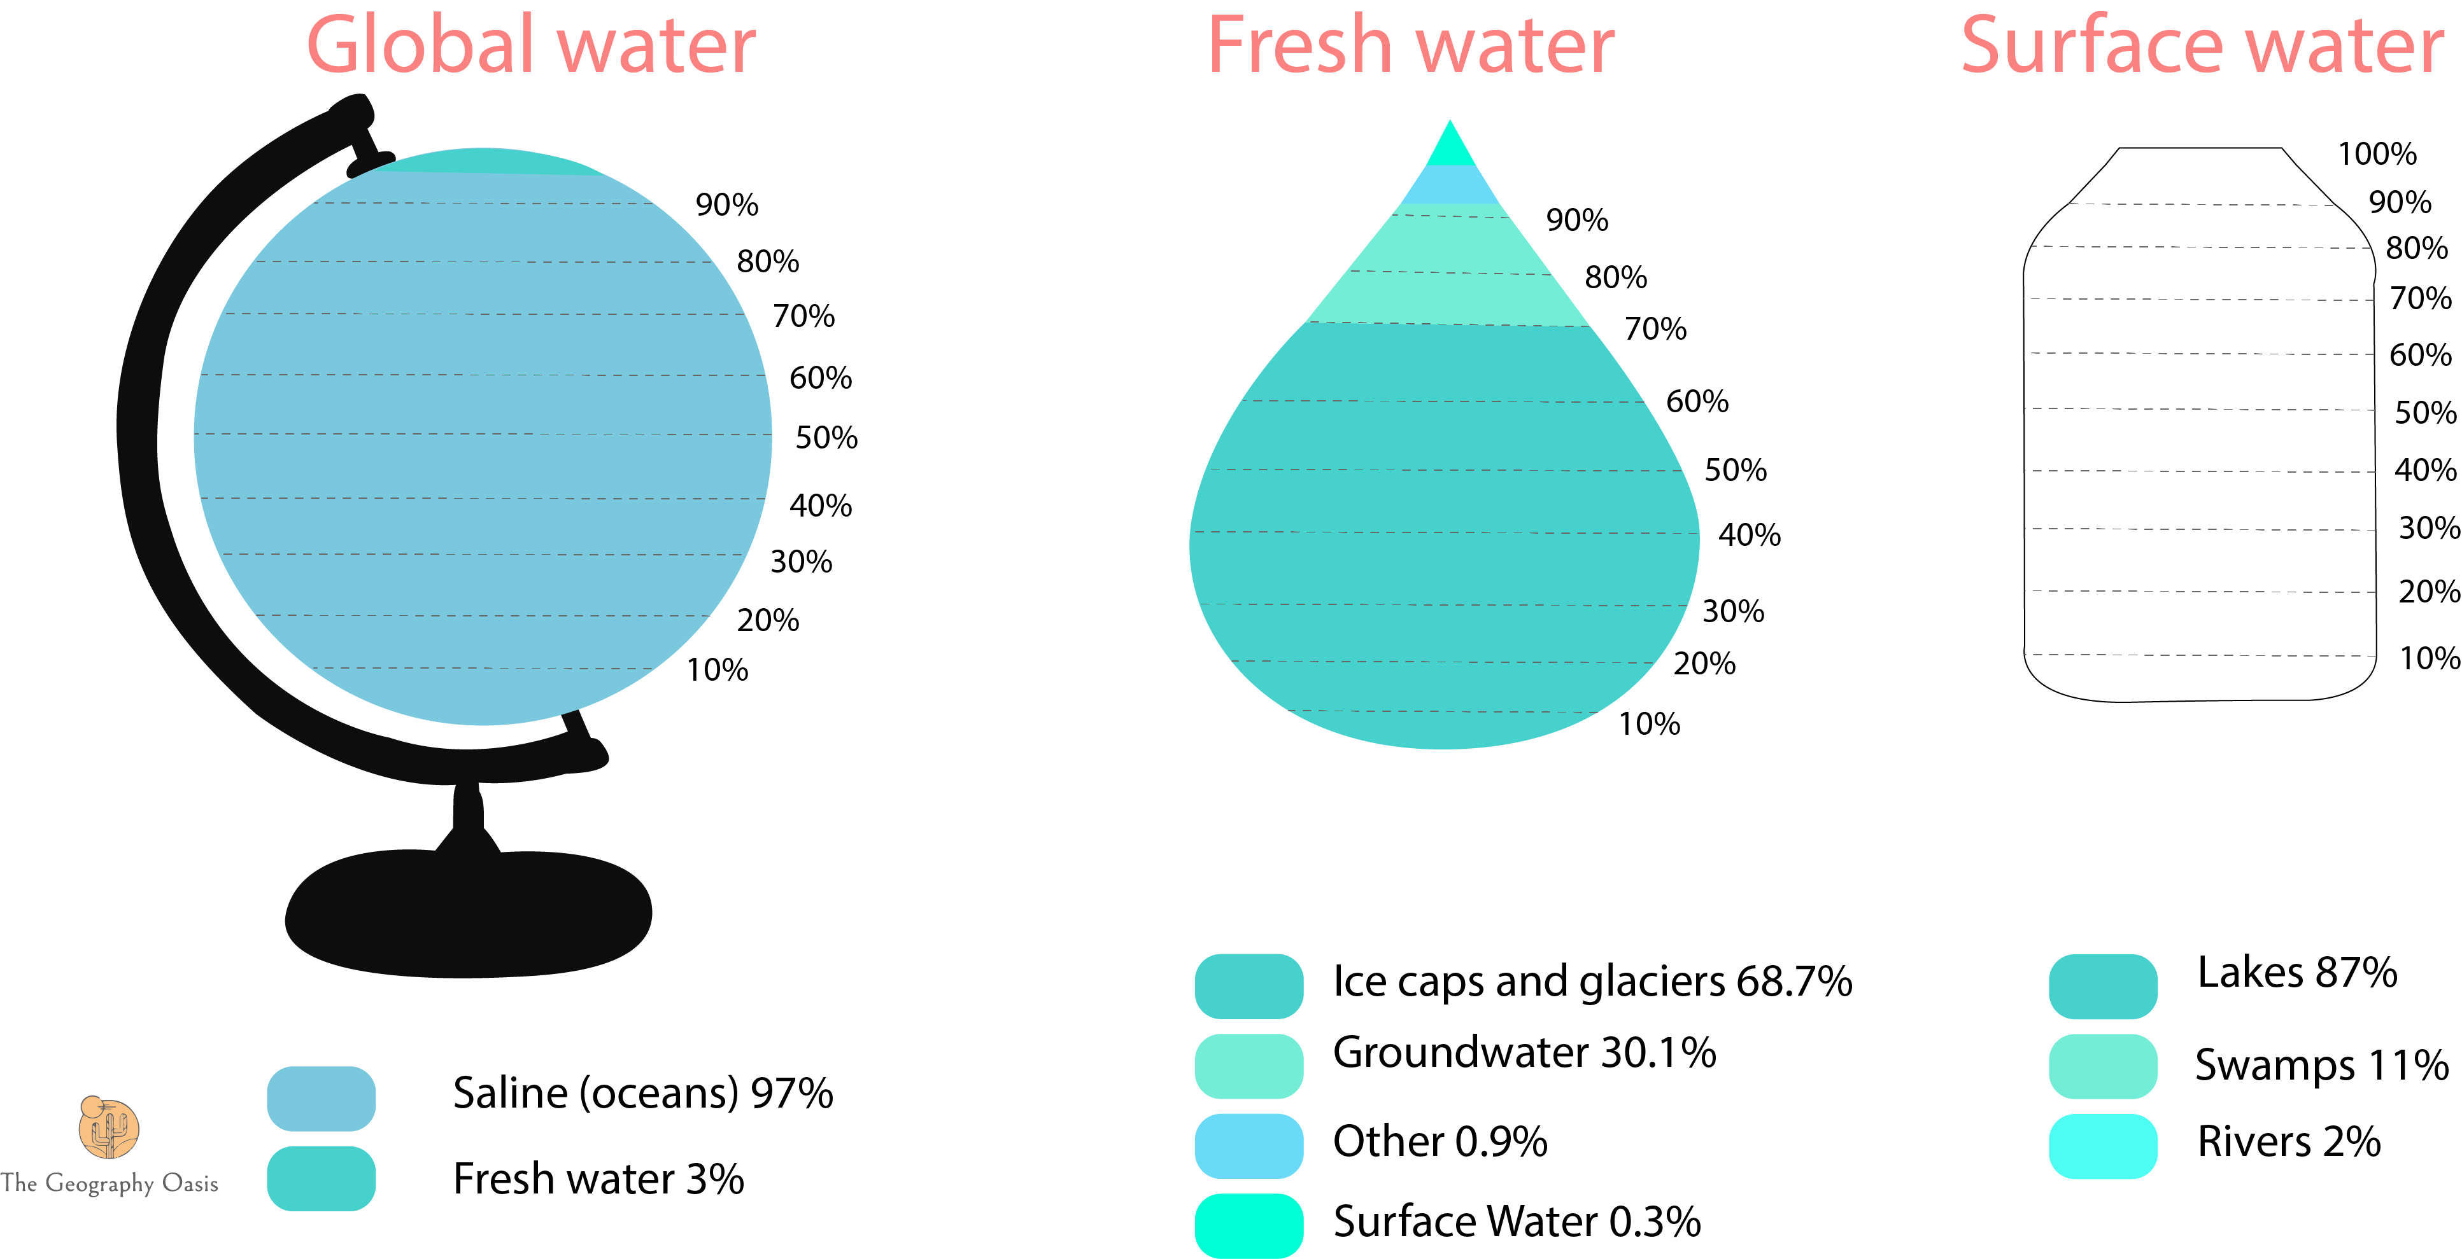
Activate
Complete the graph to show the distribution of surface water. Remember to complete the key.
EXTENSION: why is it becoming increasingly difficult to provide water for the world’s population?
Notes:
REASONS FOR WATER SCARCITY:
Growing population- Over 7 billion people on the planet and rising by around 80 million people per year.
Global warming is changing weather patterns
Distribution- water is not evenly spread across the world.
Wealth and wastage- wealthier nations tend to use more water per capita for appliance useage.
Water availability on the planet
How do humans access and distribute fresh water?
What do we use water for? Industry, domestic, agriculture
Difference is use at different levels of development
Water scarcity around the world
Causes of water scacity
Impacts of water scarcity in LEDC (Somalia) and sustainable solution
Impact of water scarcity in MEDC (Singapore- four taps)

Slide 4
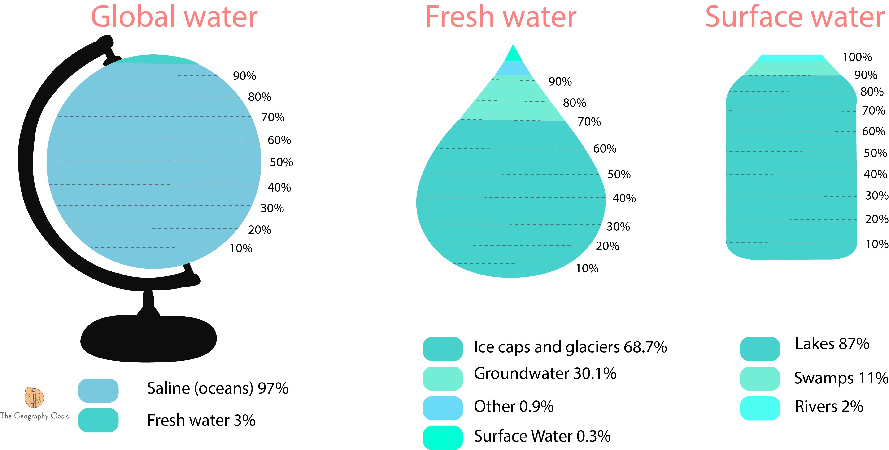
Activate
Complete the graph to show the distribution of surface water. Remember to complete the key.
EXTENSION: why is it becoming increasingly difficult to provide water for the world’s population?
Notes:
REASONS FOR WATER SCARCITY:
Growing population- Over 7 billion people on the planet and rising by around 80 million people per year.
Global warming is changing weather patterns
Distribution- water is not evenly spread across the world.
Wealth and wastage- wealthier nations tend to use more water per capita for appliance useage.
Water availability on the planet
How do humans access and distribute fresh water?
What do we use water for? Industry, domestic, agriculture
Difference is use at different levels of development
Water scarcity around the world
Causes of water scacity
Impacts of water scarcity in LEDC (Somalia) and sustainable solution
Impact of water scarcity in MEDC (Singapore- four taps)

Slide 5
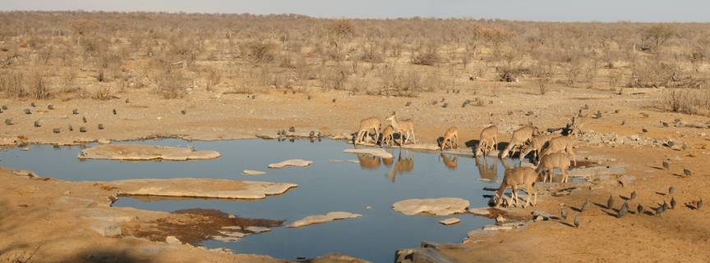
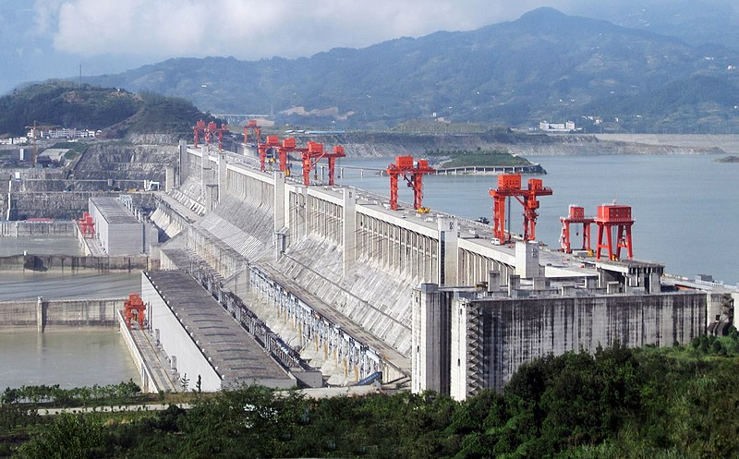
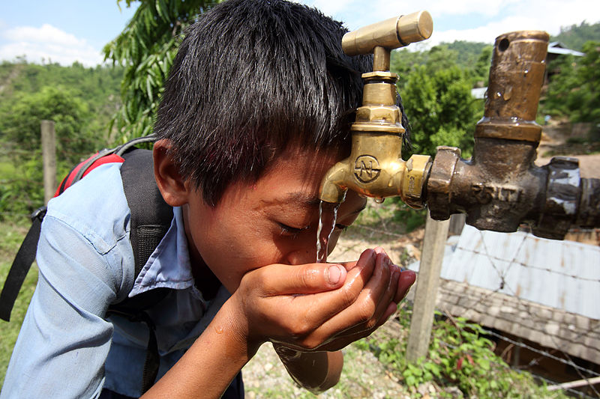
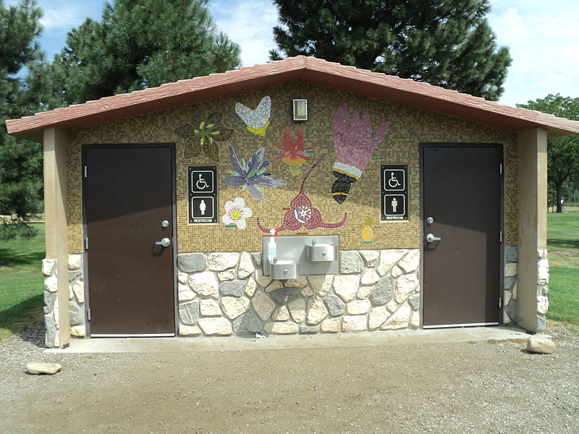
Why is Water Important?
Waterhole in Namibia
Three Gorges Dam, China
Water is a substance that is essential for supporting all life on our planet. Water is a key need for animal and plant life. A regular and reliable amount of water helps to maintain the balance within ecosystems.
Water is vital for human survival and development. It is important for drinking, cleaning and sewage disposal.
With over 7 billion people on the planet, rising by an additional 80 million people each year, water management has never been more important or more challenging.
Finally, water power is becoming increasingly important in the generation of cheap, green energy.
Boy drinks from tap in Nepal
Public Toilet
Notes:
Three Gorges Dam: Source file: Le Grand PortageDerivative work: Rehman [CC BY 2.0 (https://creativecommons.org/licenses/by/2.0)]
Nepal: AusAID/Jim Holmes [CC BY 2.0 (https://creativecommons.org/licenses/by/2.0)]
Toilet: Kencf0618 [CC BY-SA 3.0 (https://creativecommons.org/licenses/by-sa/3.0)]

Slide 6
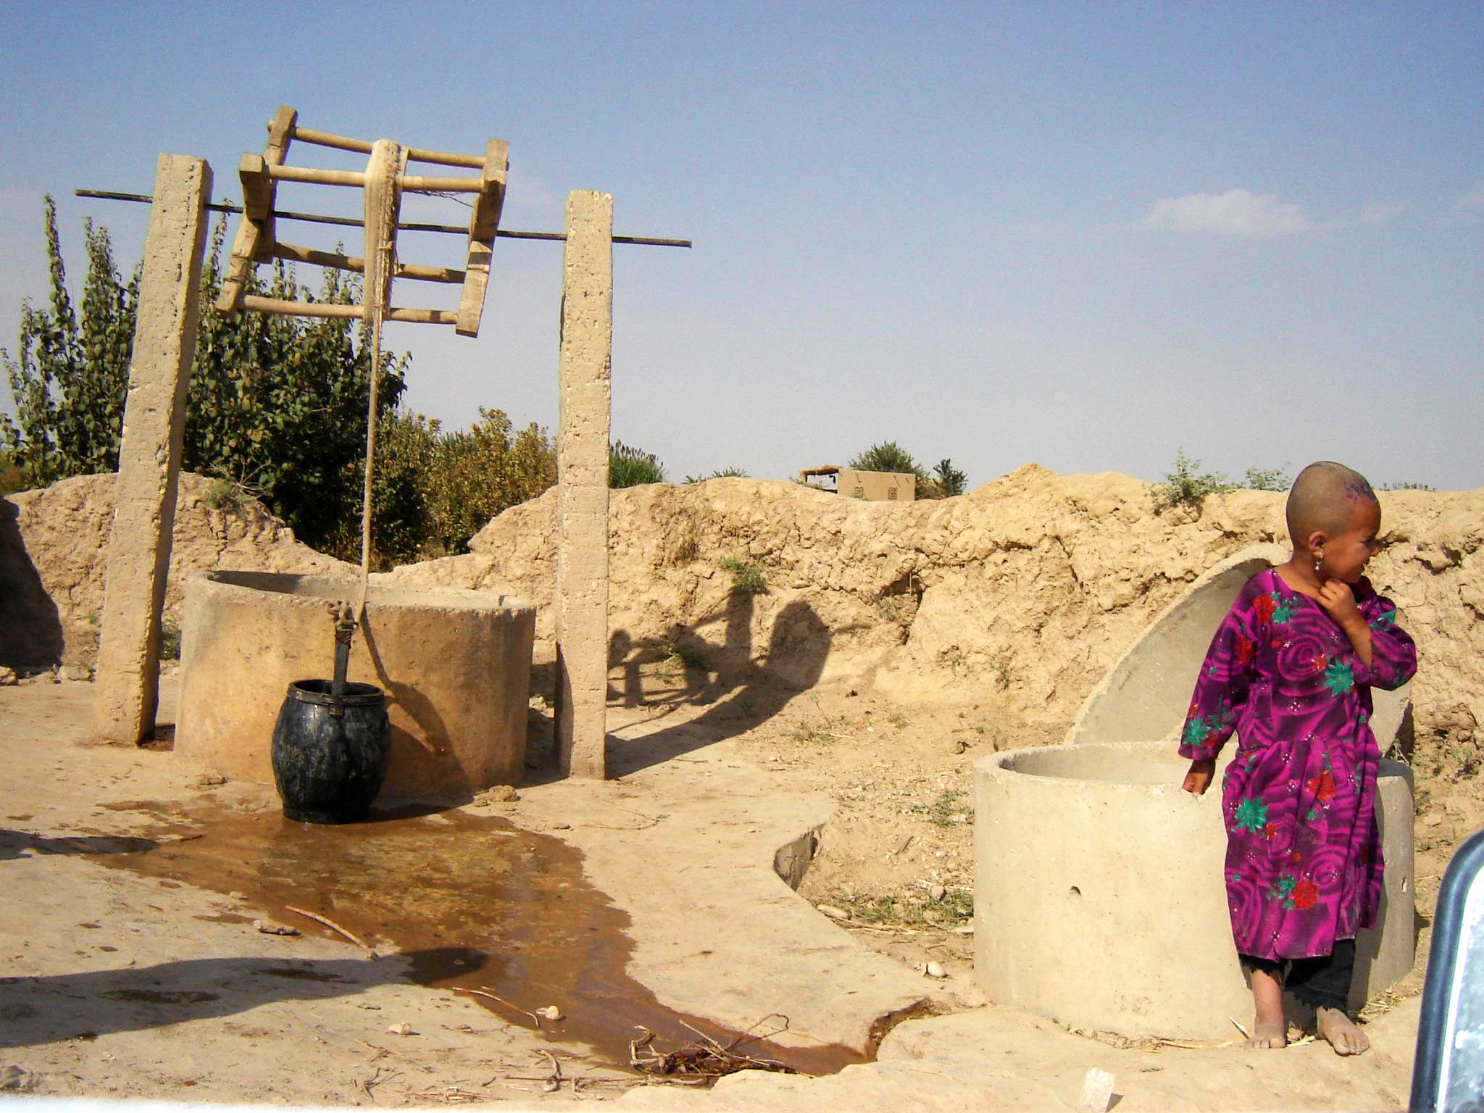
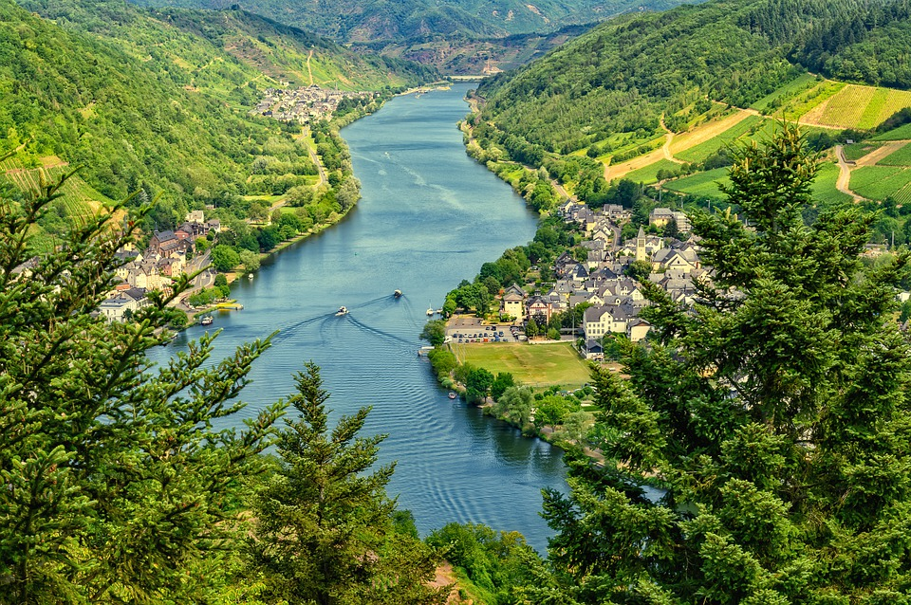
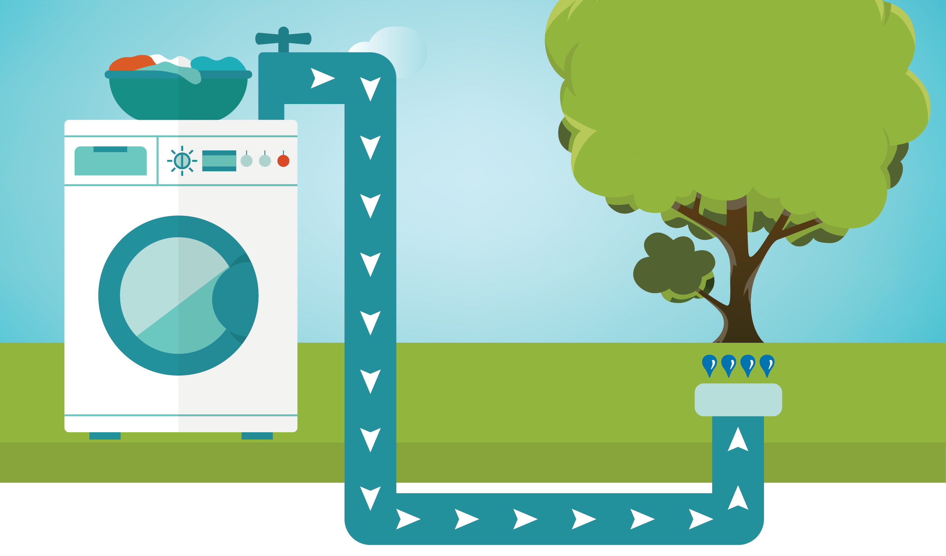
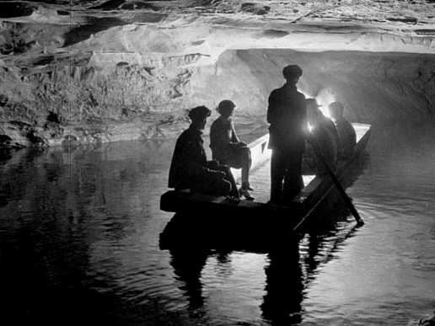
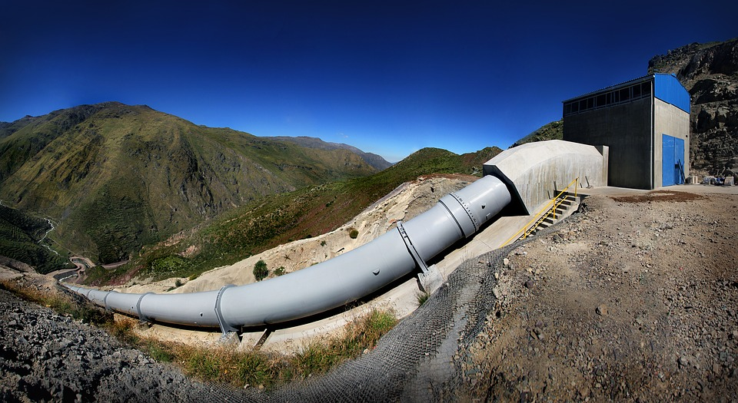
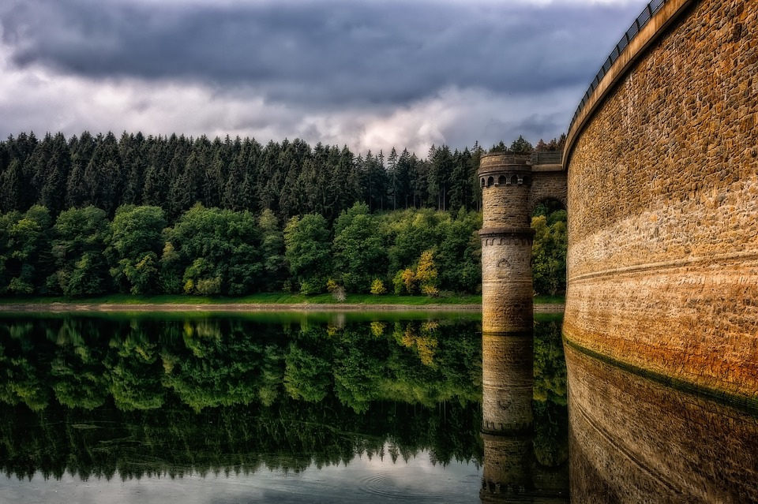
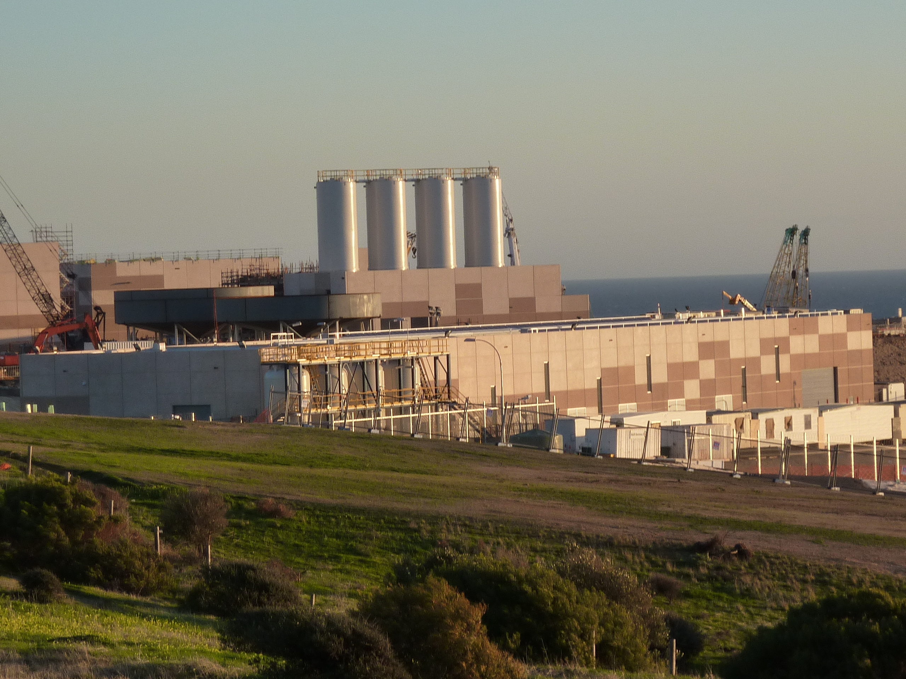
Sources of Water
ACTIVITY: Match the key words (A-G) to the correct definition. Then match them to the correct picture (1-7).
LETTER | KEYWORD
A | Reservoir and dam
B | Aquifer
C | Borehole
D | Greywater
E | River Water
F | Desalination
G | Piped/ infrastructure
Definition | WHICH LETTER? | WHICH PICTURE?
An underground store of water. Water seeps into permeable rock (a rock that allows water to pass through). It percolates down until it hits impermeable rock, where it sits in an underground lake.
The relatively clean wastewater from baths, sinks, washing machines, and other kitchen appliances.
Water is transported to homes and businesses through a network of pipes that are regularly maintained.
A deep, narrow hole made in the ground to locate water stored in aquifers.
Water is stored in a large, artificial lake behind a gigantic man-made concrete wall. This water store can be used at times of shortage or during periods of increased demand.
Fresh water carried by streams and rivers.
The process of removing salt from water. This is often done in large scale industrial plants.
B
4
D
3
G
5
C
1
A
6
E
2
F
7
1
2
3
4
5
6
7
Notes:
User:Vmenkov [CC BY-SA 3.0 (https://creativecommons.org/licenses/by-sa/3.0)]

Slide 7
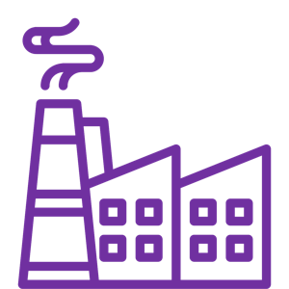


How do humans use water?
INDUSTRIAL USE
DOMESTIC USE
AGRICULTURAL USE
Industrial = to do with work and manufacturing e.g. mining, making cars or making electronics.
Water is used in most manufacturing processes - some big water uses are in making paper and petrol. Water is especially important in producing electricity.
Domestic = to do with the home.
7.8 billion people use water each and every day in their homes for cooking, bathing, washing clothes, hygiene and sanitation.
Agriculture = to do with farming.
Water is essential in food production through irrigation (artificial watering of crops) and meat production. Irrigation is the single biggest use of water around the world. Without it we would not be able to produce enough food.
Notes:
Noun Project:
Farming: By ProSymbols, US. In the Nature Landscapes Line Icons Pack Collection
Industry: By Chameleon Design, IN In the Industry Collection
Domestic: By b farias, CL In the Family Line V2 Collection

Slide 8
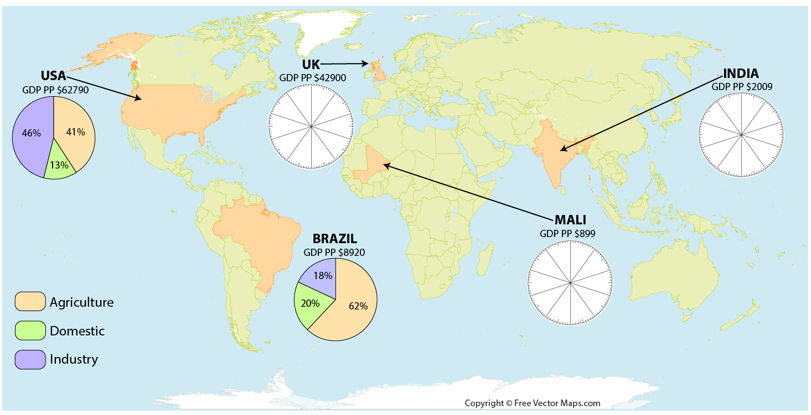
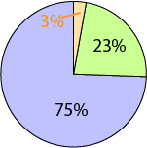
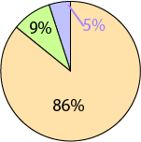
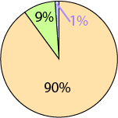
How do countries at different levels of development use water?
ACTIVITY: Use the information provided to complete the pie charts for the UK, Mali and India.
Notes:
World with Countries by FreeVectorMaps.com

Slide 9
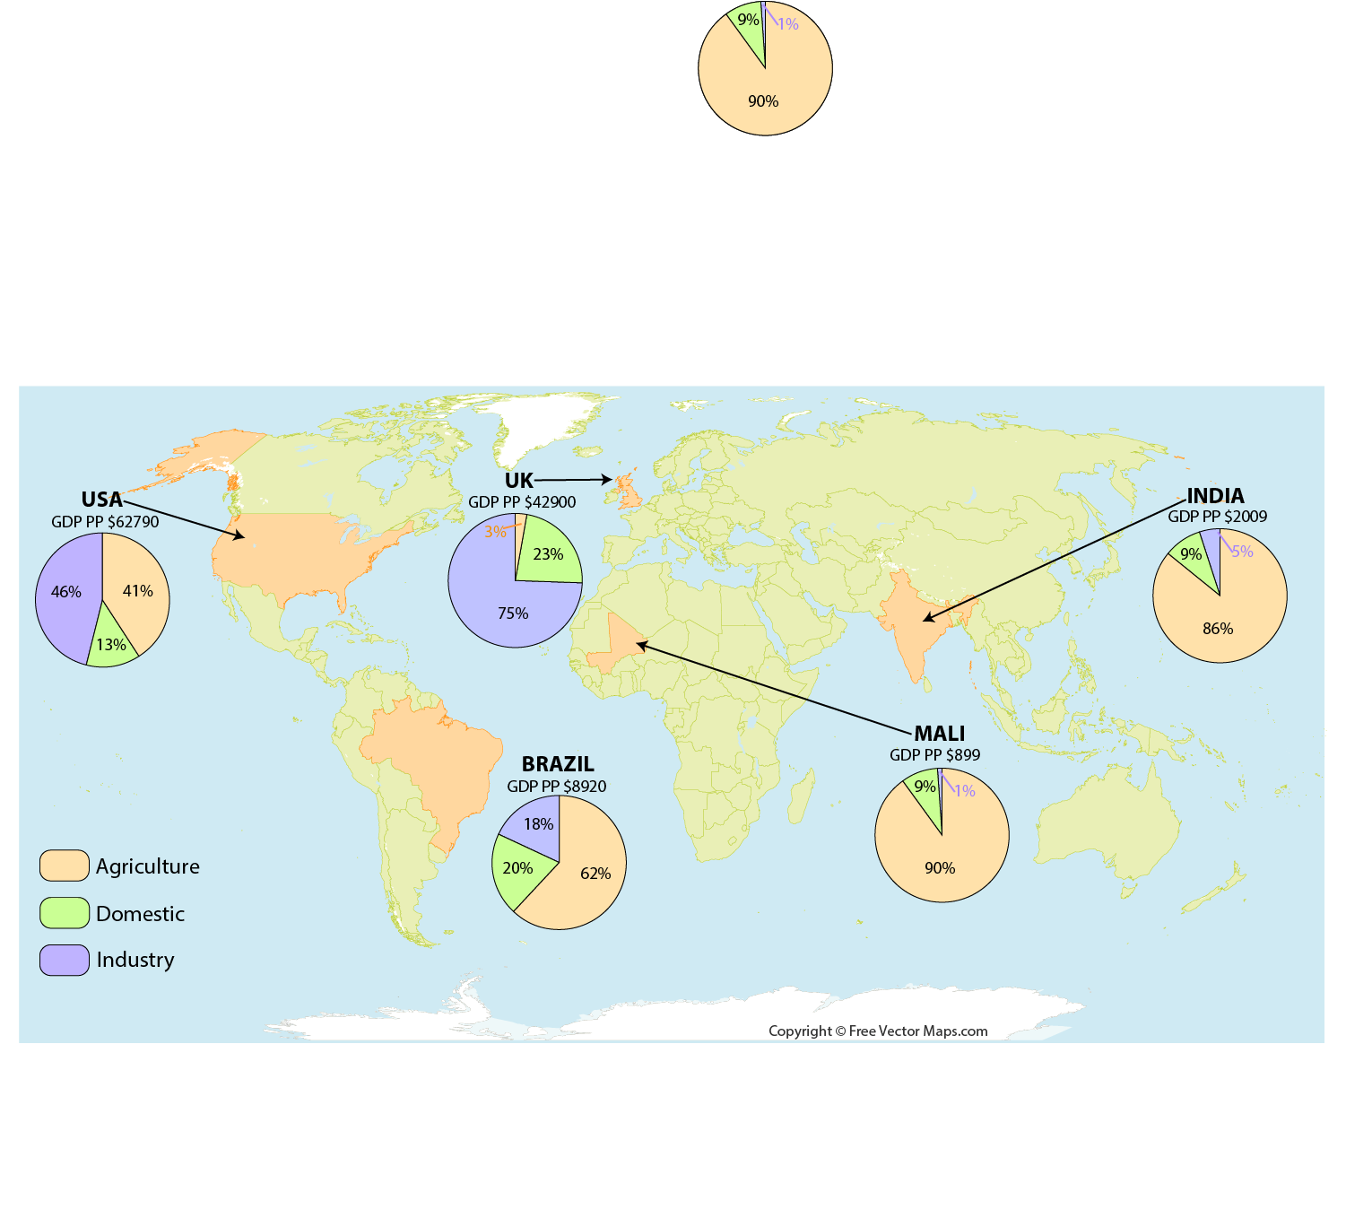
How do countries at different levels of development use water?
Generally, the more developed a country is, the sector that will consume the most water is….This is proven by the examples…
… Industry. This is proven by the example of the UK where 75% of water is used by Industry. Likewise, but to a lesser extent, industry is the sector that uses the most water in USA (46%)
Less developed countries use the majority of water for… This is proven by the examples of..
… agriculture. This is proven by the example of Mali where 90% of water use is focused on farming. Likewise, India uses over 4/5 of its water on agriculture.
One sector that never uses more than a quarter of a country’s water use is….
… The domestic sector.

Slide 10
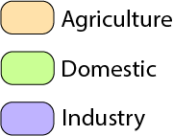
How do countries at different levels of development use water?
UK
GDP pp $42900
Suggest reasons why…
… Mali uses a greater proportion of water for agriculture and farming.
Mali will use a substantial amount of water on farming because this in one of the key forms of employment in the country, especially in subsistence farming. Low Income countries economic production is built around the primary sector. The main water use will be to irrigate crops.
… UK uses a greater proportion of water for Industry.
MALI
GDP pp $899
More developed countries are likely to have a larger secondary sector of manufacturing. Factories and heavy industries use huge quantities of water in the production of finished goods or in order to cool equipment.
… UK is likely to uses a greater proportion of water in energy production.
More developed countries are wealthier and therefore demand more electricity to power industry and domestic appliances within the home. This demand will often be provided by thermal power stations that use water for cooling.
… UK uses a greater proportion of water in the domestic sector than Mali.
Developed countries can afford to provide infrastructure to deliver water to every home through pipes and taps. Residents will have reliable access to unlimited water in the home. Therefore, they use more water. In Mali, people may have to walk long distance to access water and they can only use what they can carry. The people will have to be more considered and selective about how they use this limited water supply.

Slide 11
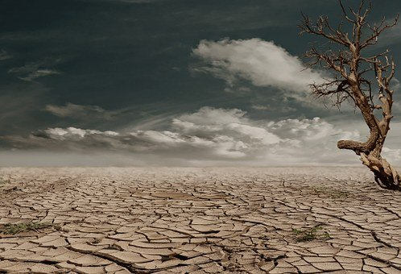
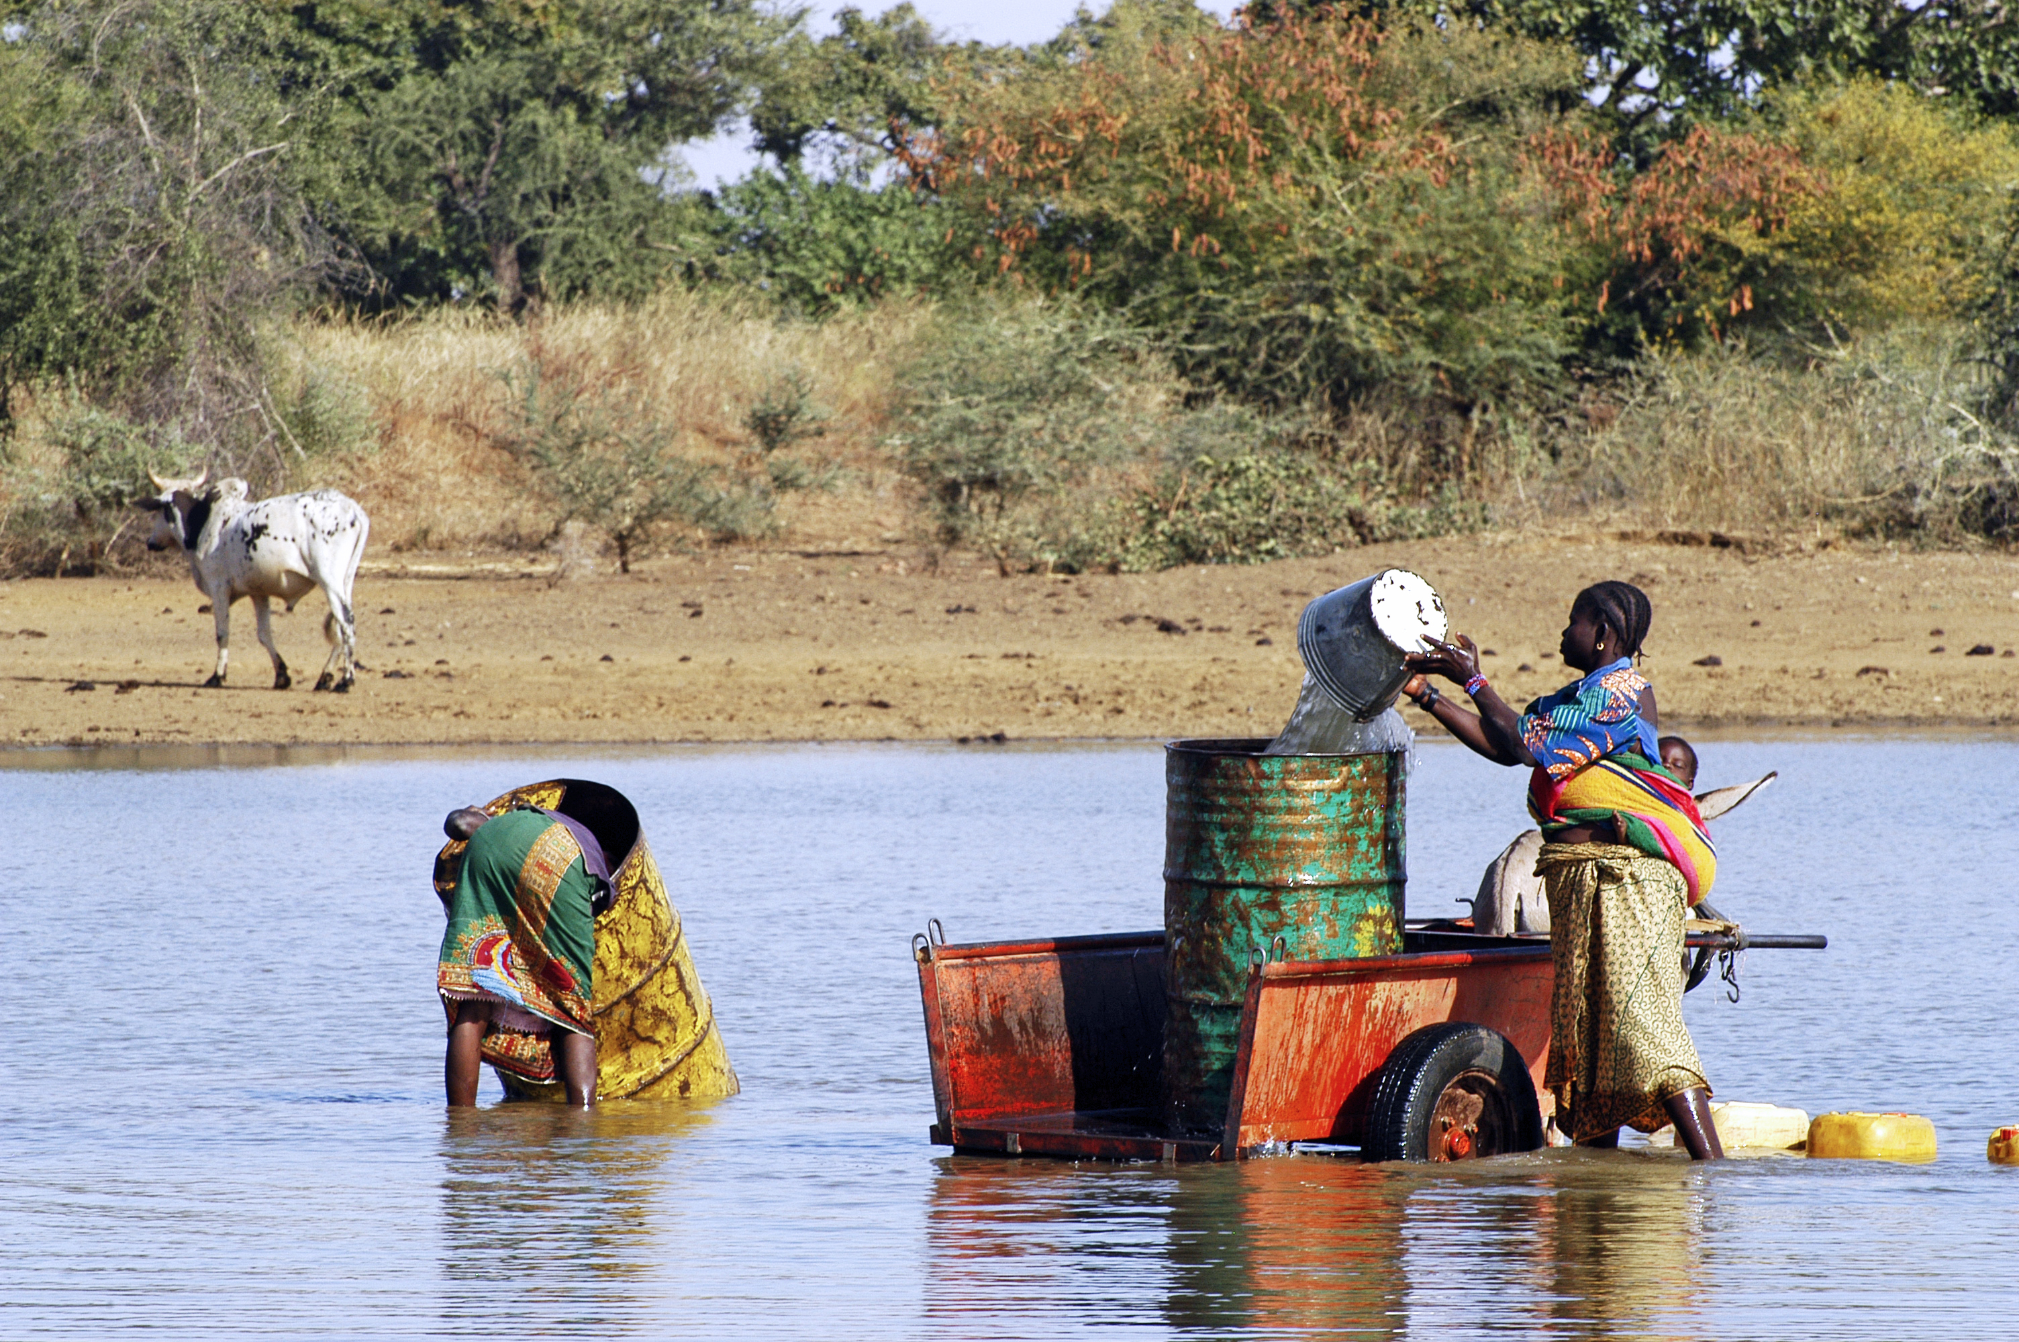
Water Scarcity
Scarcity= A shortage; or in short supply.
Water Scarcity= the lack of sufficient available water resources to meet the demands of water usage within a region.
Physical Water Scarcity= there is not enough water to meet both human demands and those of ecosystems to function effectively.
Economic Water Scarcity= a lack of investment in water (infrastructure) or a lack of human capacity to satisfy the demand for water, even in places where water is abundant. Poor water management.
Notes:
Classification
Physical water scarcity= at least 75% of available water is withdrawn from river sources for Human use.
Approaching= between 60% and 74% of available water is withdraw is withdrawn from river sources for human use.
Economic water scarcity= Areas are using less than 25% of available water from river sources, however, population is still suffering from malnutrition.
Little to no= less than 25% of available water from river sources is used.
Photograph- Bob Metcalf [Public domain]
Information source: UN water Org.

Slide 12
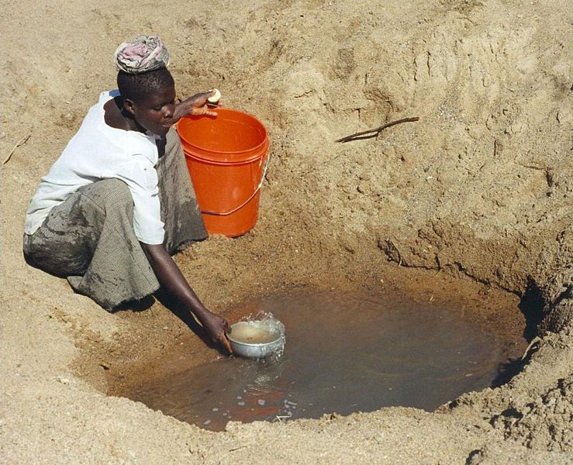
Water Scarcity
Hydrologists typically assess scarcity by looking at the population-water equation. An area is experiencing water stress when annual water supplies drop below 1,700 m3 per person. When annual water supplies drop below 1,000 m3 per person, the population faces water scarcity, and below 500 cubic meters "absolute scarcity".
FACTFILE
Approximately 1.1 billion people have no access to clean, reliable water.
4 billion people suffer from severe water scarcity for at least 1 month each year.
700 million people could be displaced due to water scarcity by 2030.
For a number of reasons, populations suffering from water scarcity are likely to increase in coming decades.

Slide 13
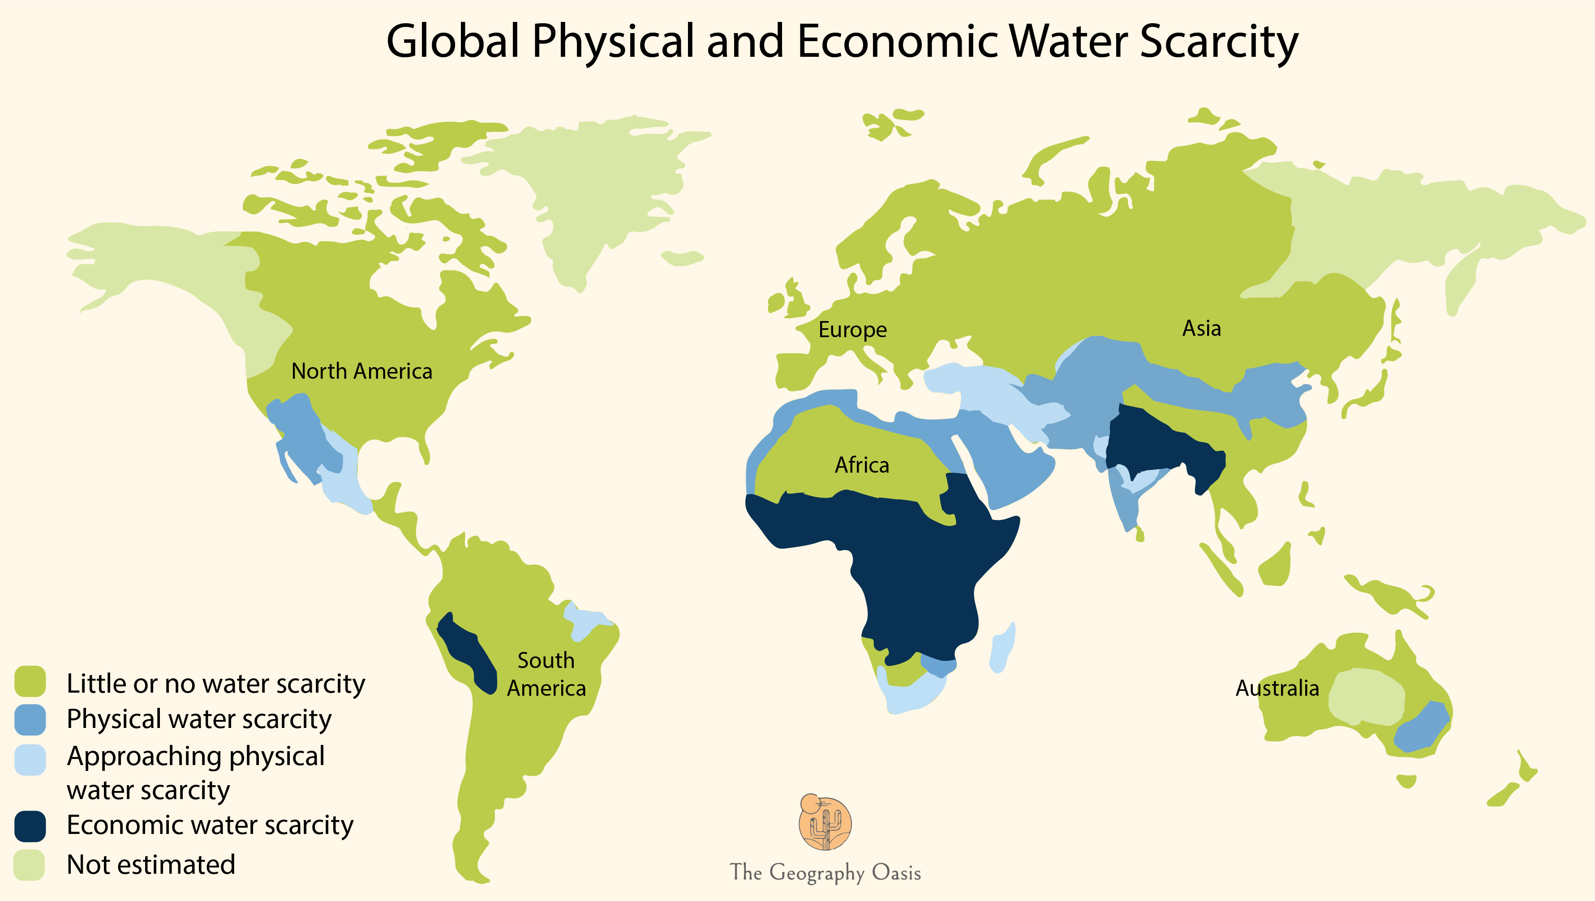
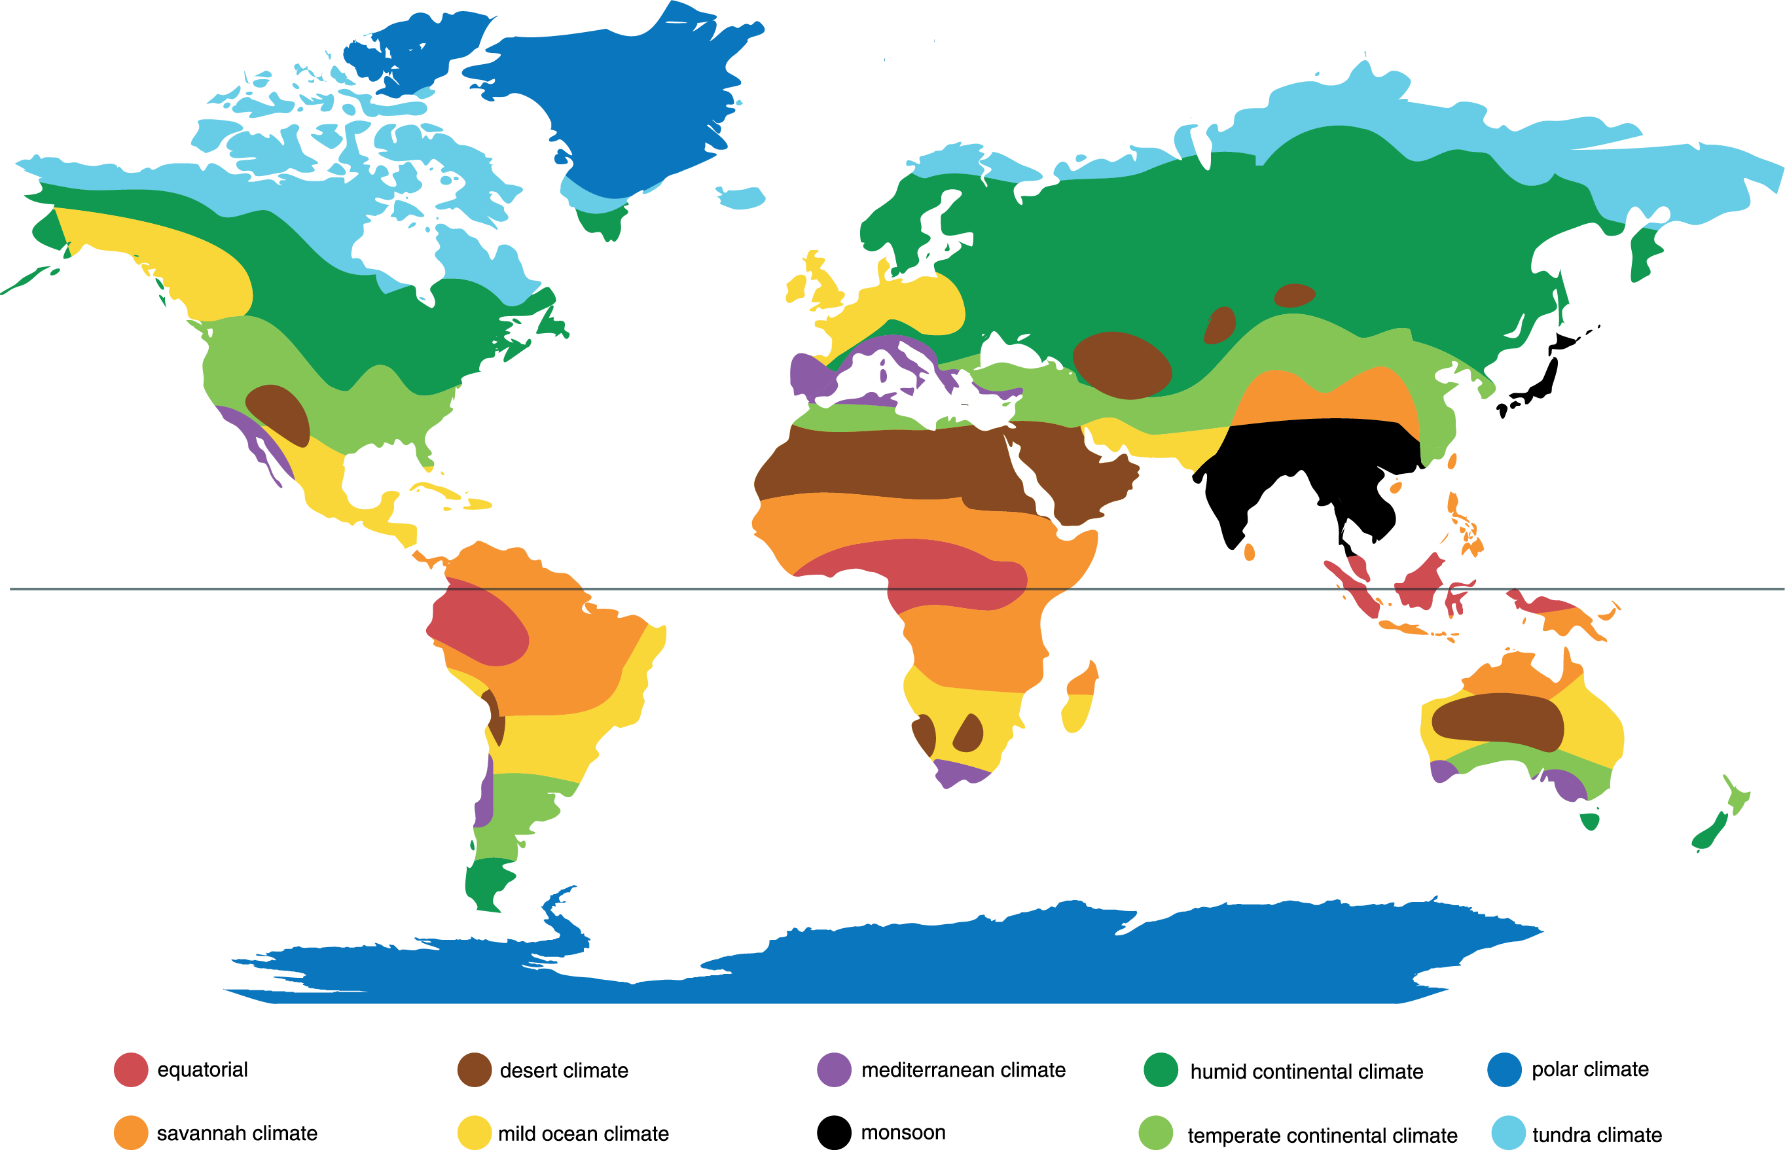
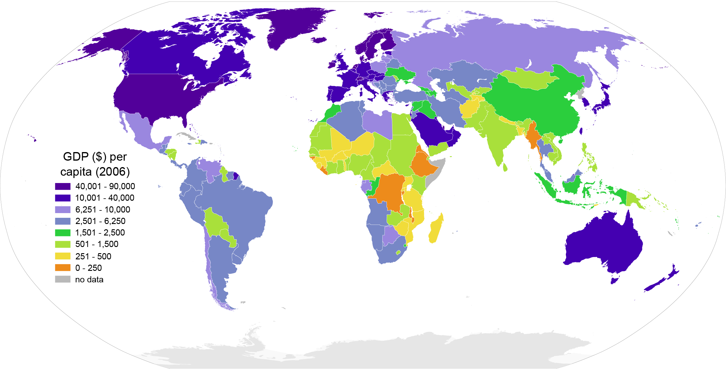
Water Scarcity
Major Climate Zones
GDP per
Capita ($)
Scarcity= A shortage; or in short supply.
Water Scarcity= the lack of sufficient available water resources to meet the demands of water usage within a region.
Physical Water Scarcity= there is not enough water to meet both human demands and those of ecosystems to function effectively
Economic Water Scarcity= a lack of investment in water (infrastructure) or a lack of human capacity to satisfy the demand for water, even in places where water is abundant. Poor water management.
Notes:
Classification
Physical water scarcity= at least 75% of available water is withdrawn from river sources for Human use.
Approaching= between 60% and 74% of available water is withdraw is withdrawn from river sources for human use.
Economic water scarcity= Areas are using less than 25% of available water from river sources, however, population is still suffering from malnutrition.
Little to no= less than 25% of available water from river sources is used.
Kloppen Classification- Peel, M. C., Finlayson, B. L., and McMahon, T. A.(University of Melbourne)Enhanced, modified, and vectorized by Ali Zifan. [CC BY-SA 4.0 (https://creativecommons.org/licenses/by-sa/4.0)]
GDP per Capita- me, Bamse, CC BY-SA 3.0 <http://creativecommons.org/licenses/by-sa/3.0/>, via Wikimedia CommonsMAP: World Water Assessment Programme (WWAP) [Public domain]

Slide 14
Water Scarcity
Describe the distribution of regions of the World that experience physical water scarcity. Circle the correct options below:
Northern coastline of Africa
Northern Europe
USA-Mexico border
South East Australia
Central Africa
Northern China
Describe the distribution of regions of the World that experience Economic water scarcity. Circle the correct options below:
Europe
Sub-Saharan Africa
Northern India and parts of central Asia
North-East South America (Brazil)
Central-western South America around Peru, Ecuador

Slide 15
Water Scarcity
Major Climate Zones
Describe the relationship between the location of areas of physical water scarcity and the distribution of global climates
The areas of physical water scarcity are found in the driest climatic zones. For example, the northern coastline of Africa and the Middle East are located close to or inside of hot desert climates (e.g. Sahara Desert). Areas of central Asia are located in dry continental climates (cold deserts). A lack of rainfall is the main reason for a physical lack of water.

Slide 16
Water Scarcity
Describe the relationship between the location of areas of economic water scarcity and GDP per Capita.
The Sub-Saharan region is the area of the world with the lowest GDP per capita and nearly all countries suffering from economic water scarcity. The vast majority of countries in this region have a GDP per capita of under $6250 per year, with many countries under $1500 per year. Likewise, those parts of Central Asia suffering from economic water scarcity also have GDP per Capita of under $2500. Even the examples highlighted in South America have a GDP per Capita below $6250. It is clear that low GDP per capita can contribute towards economic water scarcity.

Slide 17
Water Scarcity
Water scarcity is a global problem that is set to increase in coming decades. Freshwater withdrawals have tripled over the last 50 years. Demand for freshwater is increasing by 64 billion cubic meters a year (1 cubic meter = 1,000 liters). Why is this a growing problem?
ACTIVITY: Unscramble the anagrams to discover the reasons for increased water scarcity. Match this to a KEY FACTS box by drawing an arrow to the correct box. Finally, add the correct secondary impacts into the correct box.
Causes of increased scarcity (anagrams)
UOIOPLAPTN WTGOHR
TCMELIA NCGEHA
GRICRELTAUU
LLPOUNTIO
CEIOCNMO EMETVDLONPNE
KEY FACTS
This process is resulting in more droughts and more evaporation of surface storage water.
Rivers are becoming increasingly under threat due to effluent from factories and eutrophication from farming.
This is increasing by 80 million each year. Water is finite and can not be increased.
People are becoming richer and therefore demanding more water to support their lifestyles and products.
Water is used for irrigation. Much of this is wasted due to inefficiencies and poor practices.
SECONDARY IMPACTS
KEY FACTS
This is increasing by 80 million each year. Water is finite and can not be increased.
This process is resulting in more droughts and more evaporation of surface storage water.
Water is used for irrigation. Much of this is wasted due to inefficiencies and poor practices.
Rivers are becoming increasingly under threat due to effluent from factories and eutrophication due to farming.
People are becoming richer and therefore demanding more water to support their lifestyles and products.
The finite water supply has to be distributed across more people.
This fuels urbanization and cities will demand more water to provide for services.
POPULATION GROWTH
Longer droughts will push people off the land and increase migration.
Increasing political conflict over who is to blame and how this global issue should be addressed.
CLIMATE CHANGE
Water is essential for agriculture so a lack of it can affect crop yields.
Results in higher prices of food for consumers.
Livestock may die.
AGRICULTURE
People may have to drink contaminated water
it kills organisms that depend on these water bodies.
Cholera and diseases as a result of poor drinking water from contaminated waters.
POLLUTION
Manufacturing, shops, tourism require water.
Businesses may relocate to guarantee water resulting in negative impacts on the economy of some areas.
ECONOMIC DEVELOPMENT
Finite= limited or a set amount.
Drought= A prolonged period of time without significant rainfall.
Irrigation= Supplying water to the land to help crops to grow.
Effluent= liquid industrial waste or sewage discharged into a river or the sea.
Eutrophication= an excess amount of nutrients from fertilizers being put into a body of water, which causes algal blooms to grow.

Slide 18
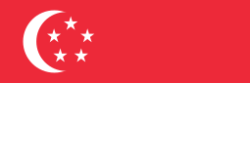
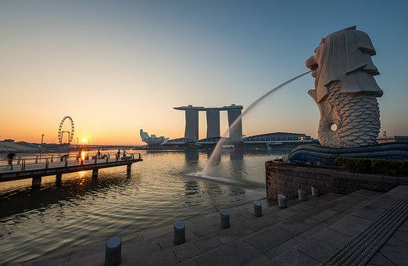
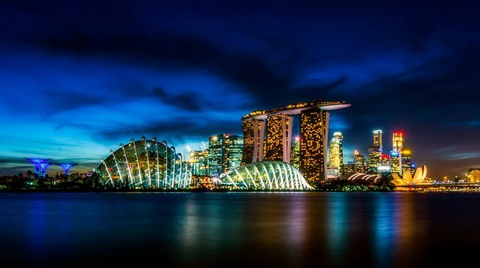
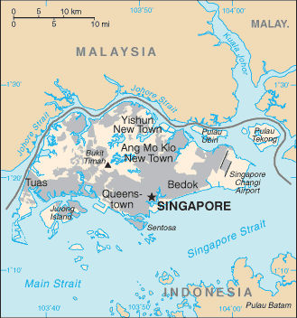
Water Scarcity Case Study: High Income country, Large Scale, High-tech: Singapore
Why is providing water a challenge in Singapore?
Singapore is a relatively small island that is home to 6 million people and rising. Singapore’s population density of 7257 people/km² is ranked the third most dense in the world. Although this is a tropical equatorial climate that receives 2350mm of rain annually, it does suffer from a lack of space to collect and store rainwater.
Rain does not fall evenly over the year and the country experiences periods of drier weather. Water demand in Singapore is currently about 430 million gallons a day. That is enough to fill 782 Olympic-sized swimming pools, with homes consuming 45% and the non-domestic sector taking up the rest. By 2060, Singapore's total water demand could almost double in line with growing population and wealth.
Population | 5,995,000
HDI | 0.932 (#9)
Life expectancy | 85.5 years
GDP Per Capita ($) | $57,700
Mean years of schooling | 16 years
Access to sanitation | 100%
Access to clean water | 100%
Area (Km²) | 719
Notes:
Noun project Images:
Flood By Smalllike In the Rainy Collection
tap By Alvaro Cabrera, Spain In the Water and drop Collection
Water By Icongeek26 In the Invoice Collection
water-treatment By Carlos Dias, PT
https://www.pub.gov.sg/watersupply/singaporewaterstory
https://www.chijournal.org/C375

Slide 19
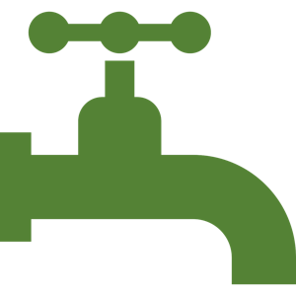
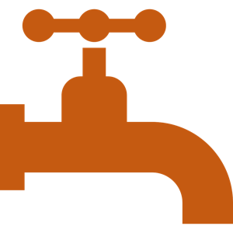
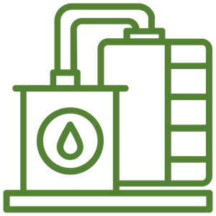

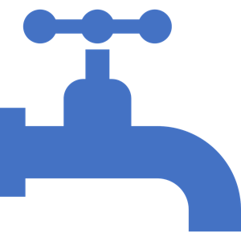

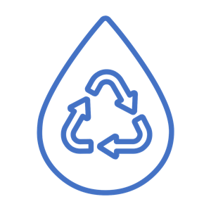

Water Scarcity Case Study: High Income country, Large Scale, High-tech: Singapore
Solutions to water challenges in Singapore: The 4 Taps Programme
TAP 1: Catching and storing rainwater
TAP 2: Importing rainwater from Malaysia
Stormwater runoff is now captured from two-thirds of Singapore’s land area and stored in seventeen reservoirs throughout the island for subsequent use. They are supported by an incredible network of infrastructure. The reservoirs receive discharge from approximately 7 000 km of man-made drains and canals.
Singapore signed 2 water agreements with neighbors Malaysia in the early 1960s. Fresh water is piped on to the island from the Malaysian state of Johor. This provides 250 million gallons of water each day. The agreement will run until 2061, however, it is uncertain if it will be continued beyond this date
TAP 3: NEWater
TAP 4: Desalination
Five NEWater plants now provide 60 million gallons of water each day, which meets 30% of Singapore’s water demands. The NEWater plants accept treated wastewater and then further treat this wastewater using a three-stage process that includes microfiltration, reverse osmosis and ultra-violet disinfection to produce water that meets World Health Organization drinking water standards. However, most of the treated water is used in industrial processes.
Singapore currently has three desalination plants with a combined capacity of 130 million gallons a day that can meet up to 30% of Singapore’s current water demand. Two more desalination plants will be ready by 2020. Desalinated water is expected to meet up to 30% of Singapore’s future water needs by 2060.
Notes:
Noun project Images:
Flood By Smalllike In the Rainy Collection
tap By Alvaro Cabrera, Spain In the Water and drop Collection
Water By Icongeek26 In the Invoice Collection
water-treatment By Carlos Dias, PT
https://www.pub.gov.sg/watersupply/singaporewaterstory
https://www.chijournal.org/C375

Slide 20

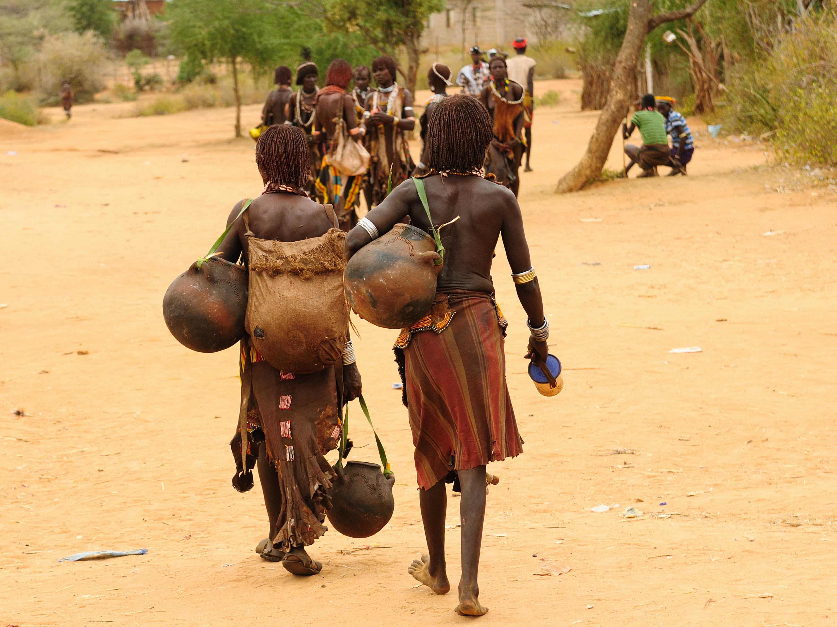
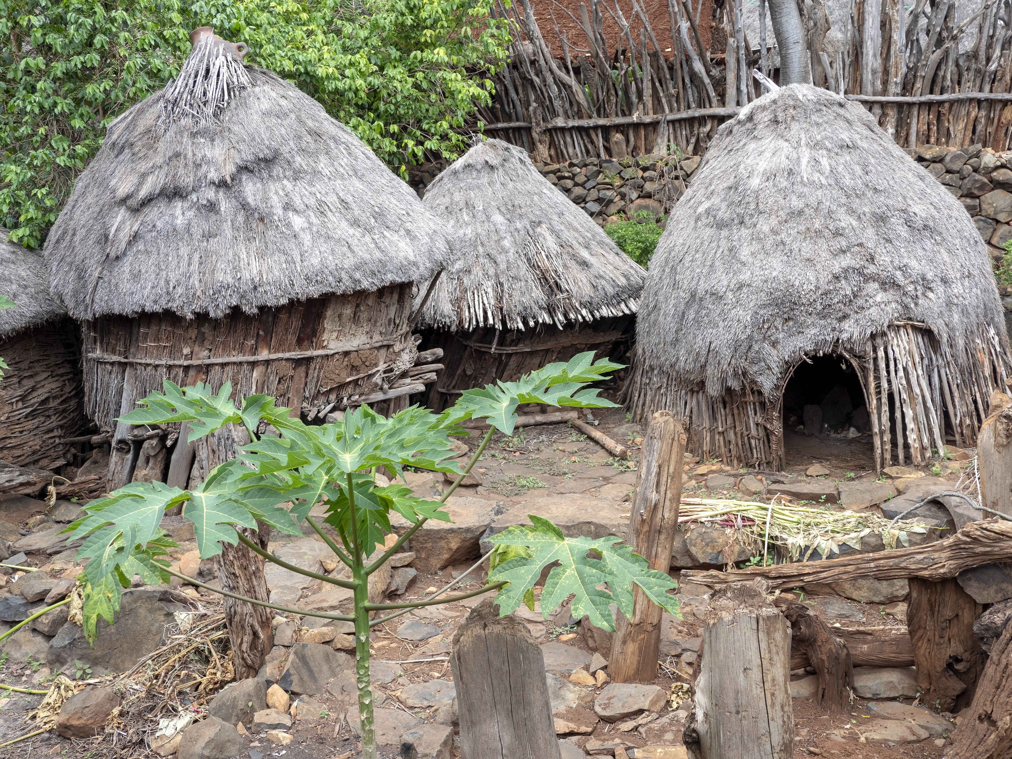
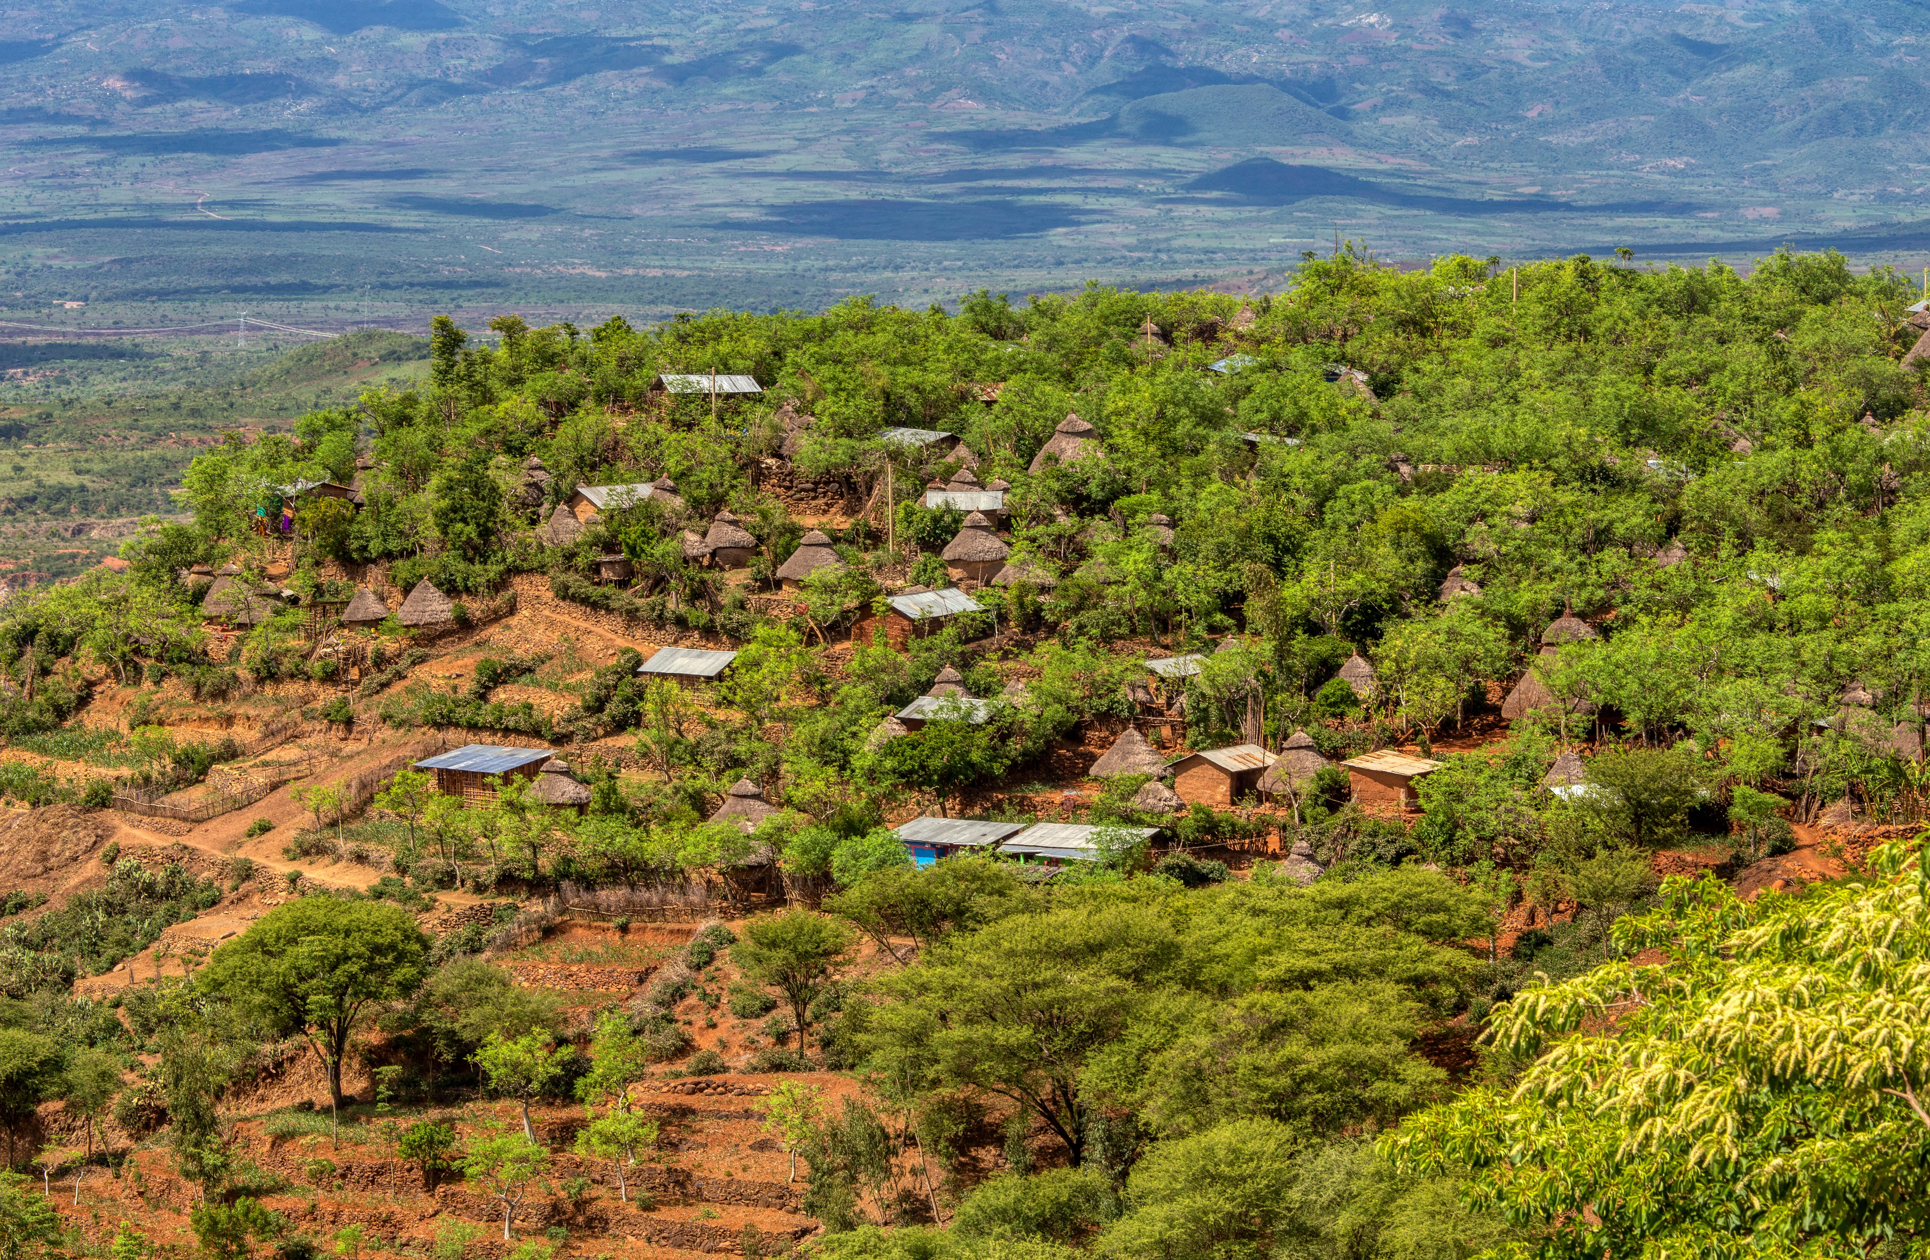
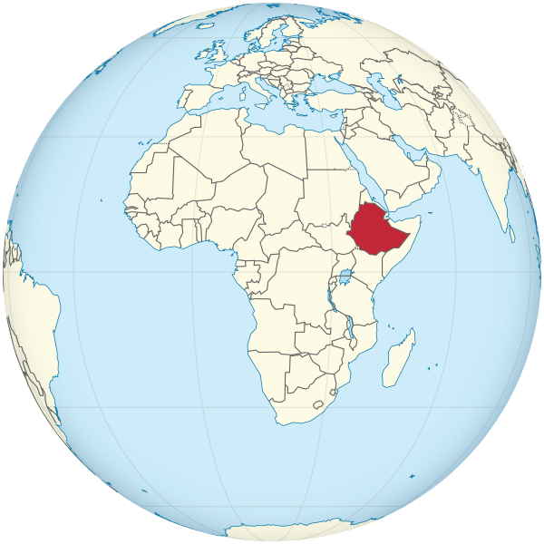
Water Scarcity Case Study: Low Income Country, small-scale, Low-tech- Konso, Ethiopia
Why is providing water a challenge in Ethiopia and the village of Konso?
Located in southwest Ethiopia, the Konso highlands are an impressive upland landscape covering over 200km² and home to approximately 235,000 people. Much of Ethiopia’s agricultural land is situated above 1500m on steep and highly erodible slopes. This steep landscape, in combination with flash flooding, can result in significant downslope soil erosion. This a dry and warm climate with an annual average rainfall of 507mm. However, some months average less than 20mm of rain. When rains do arrive, they can be short and intense leading to flash flooding. Overall, there is limited rainfall that falls quickly on to steep surfaces that drain away the water rapidly. This makes collecting and storing water for domestic and agricultural use very challenging.
Population | 108,386,000
HDI | 0.463 (#173)
Life expectancy | 63 years
GDP Per Capita ($) | $2,200
Mean years of schooling | 8 years
Access to sanitation | 28%
Access to clean water | 57.3%
Area (Km²) | 1,104,300
Notes:
Flag: Drawn by User:SKopp [Public domain]
Map: TUBS [CC BY-SA 3.0 (https://creativecommons.org/licenses/by-sa/3.0)]
https://arreaproject.files.wordpress.com/2017/11/01-aarea-policy-brief-no-1-terraces-are-good-but-sometimes-sediment-traps-are-better.pdf
https://www.researchgate.net/publication/311494714_Indigenous_Practices_of_Water_Management_for_Sustainable_Services_Case_of_Borana_and_Konso_Ethiopia

Slide 21
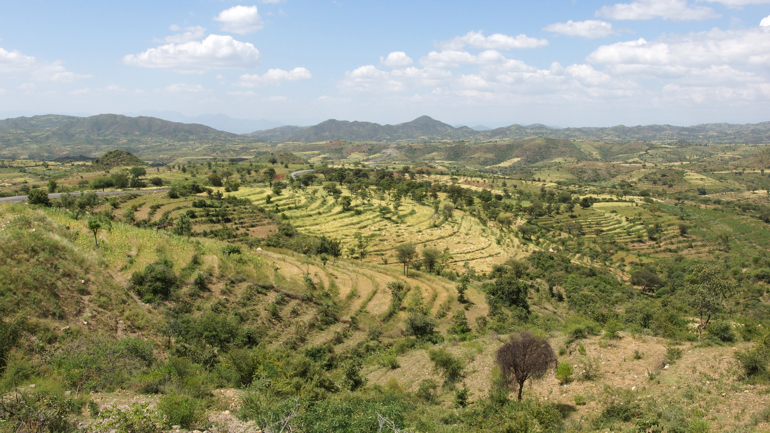
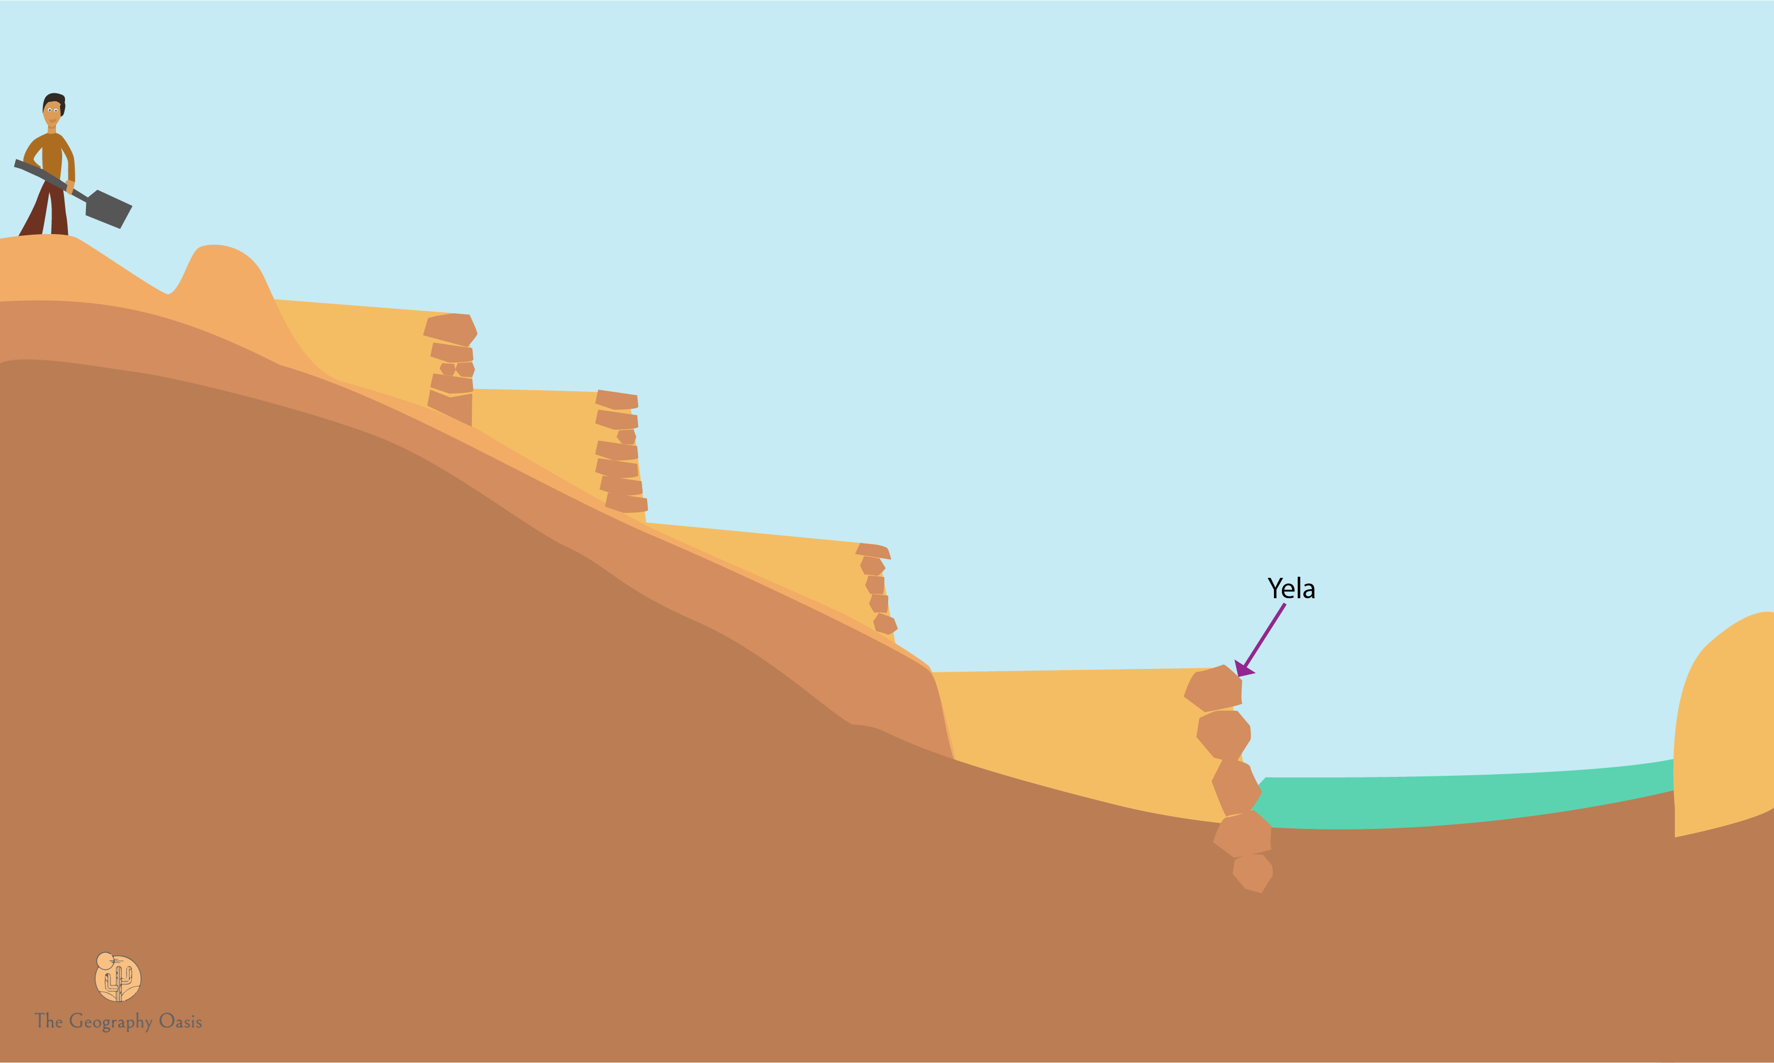
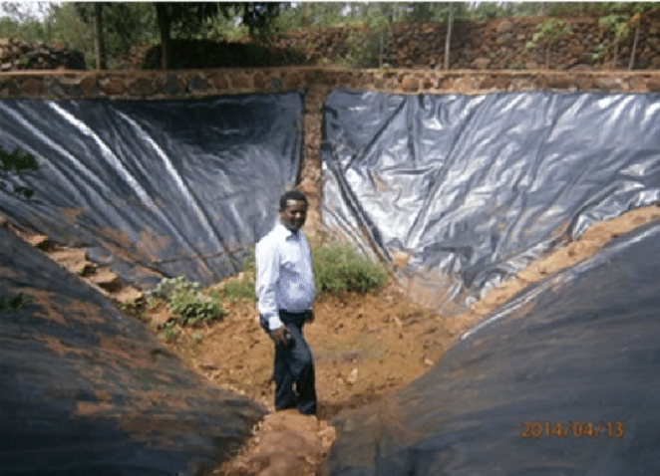
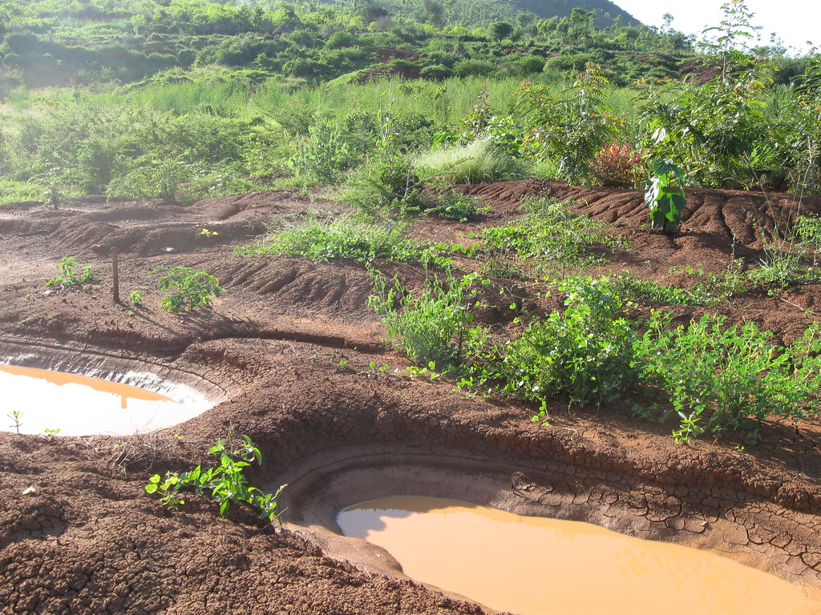
Water Scarcity Case Study: Low Income Country, small-scale, Low-tech- Konso, Ethiopia
Solutions to water challenges in Konso
Horizontal terracing
Spill overs ponds
Sediment trapping
The Konso built kilometers of terracing. They cut flat levels into the steep slopes. This helped to hold the soil in place. This was aided by the planting of drought-resistant, multi-function trees that hold the soil together. The flat terraces allow for water to infiltrate into the soil to provide water for crops.
The local community have built spill over ponds to collect surplus flood water that flows off of the land. These are placed in the best strategic position to capture the water. The water can be used for irrigation.
Sediment traps or ‘Yelas’ have been constructed inside dry river channels at the base of slopes. These channels trap larger sediment thus keeping the main river water clearer and cleaner. They have been effective at trapping charcoal rich soils from slash and burn processes. They work well in combination with terracing to prevent soil erosion.
Notes:
Flag: Drawn by User:SKopp [Public domain]
Map: TUBS [CC BY-SA 3.0 (https://creativecommons.org/licenses/by-sa/3.0)]
https://arreaproject.files.wordpress.com/2017/11/01-aarea-policy-brief-no-1-terraces-are-good-but-sometimes-sediment-traps-are-better.pdf
https://www.researchgate.net/publication/311494714_Indigenous_Practices_of_Water_Management_for_Sustainable_Services_Case_of_Borana_and_Konso_Ethiopia

Slide 22
1. Why might many Singaporean’s be concerned about importing a large percentage of their water needs from another country?
Arguments and disagreements could surface that threaten the water flow. This could, in extreme circumstance, lead to conflict.
How can the 2 countries insure a fair price for all if costs rise/fall?
How might climate change impact on the availability of water?
2. ‘Water shortages in Konso are more to do with physical factors rather than economic factors’ To what extent do you agree? Give reasons for your answer.
PHYSICAL FACTORS- low annual rainfall (507mm) with some months having average rain under 20mm. Steep, rocky terrain encourage soil erosion and surface runoff.
ECONOMIC FACTORS: Low GDP per capita in Ethiopia ($2200) results in insufficient capital to invest in water treatment and infrastructure/pipes.
3. The examples of water management in Konso, Ethiopia, are described as ‘low-tech’. From studying those examples, suggest some of the key features of low-tech approaches:
Cheap to make / buy; Simple to assemble / use; Adaptable to different environments; Requires no electrical power to operate; Durable; Doesn’t require technical knowledge

Slide 23
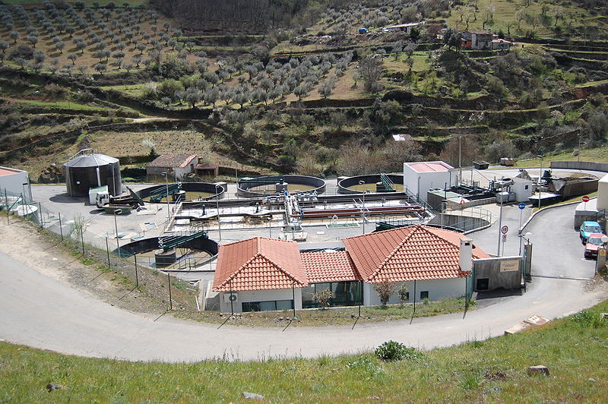
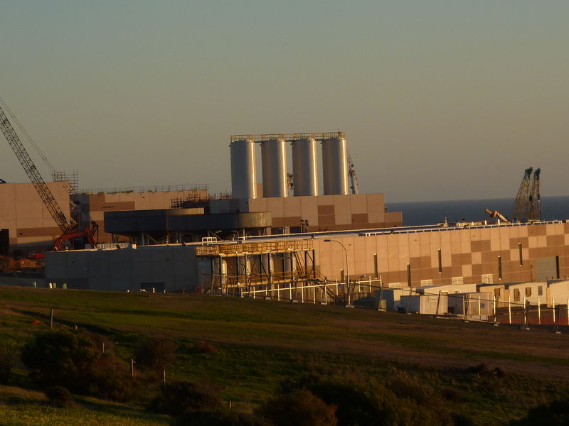
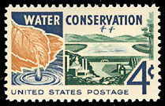
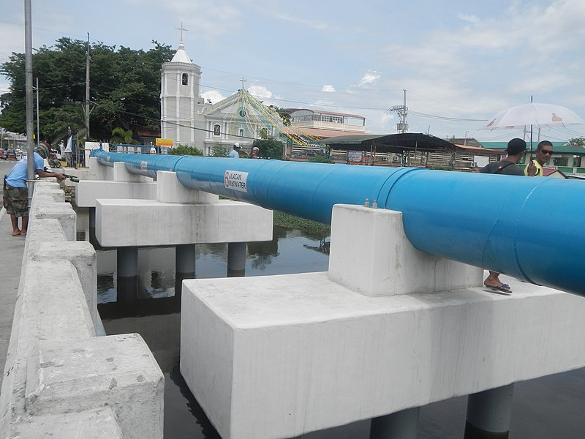
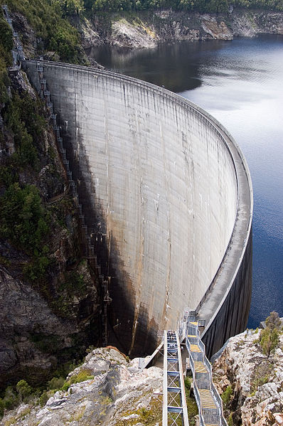
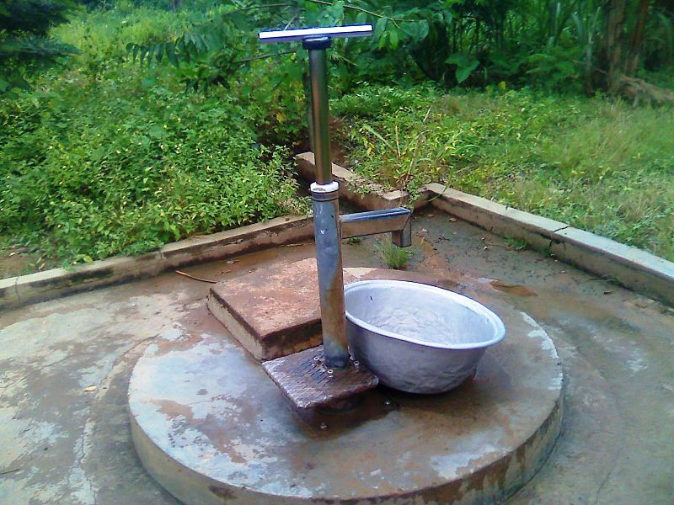


Review
Study the water management strategies below. Discuss how they provide water. Decide if each example would be more appropriate for a High-Income Country (HIC) or a Low-Income Country (LIC)
1. Water treatment plant
2. Desalination
3. Education about conserving water
4. Improve Water Pipes/Infrastructure
High Income Country
High Income Country
Both
High Income Country
5. Build dams/reservoirs
5. Dig more boreholes/wells
7. Cloud Seeding
8. Water collection (harvesting)
High Income Country
Low Income Country
High Income Country
Low Income Country
Notes:
Desalination plant: User:Vmenkov [CC BY-SA 3.0 (https://creativecommons.org/licenses/by-sa/3.0)]
Borehole: Nkansahrexford [CC BY-SA 3.0 (https://creativecommons.org/licenses/by-sa/3.0)]
Cloud Seeding: Pearson Scott Foresman [Public domain]
Water treatment: User:Dantadd [CC BY-SA 2.5 (https://creativecommons.org/licenses/by-sa/2.5)]
Water pipe: Judgefloro [CC0]

Slide 24

Water Shortages
Key Understandings
Approximately 1.1 billion people have no access to clean, reliable water.
4 billion people suffer from severe water scarcity for at least 1 month each year.
700 million people could be displaced due to water scarcity by 2030.
Although water scarcity can be caused by a physical lack of water through low rainfall, it is mainly due to economic factors. Governments can not afford to provide clean water for their citizens.
METACOGNITION CORNER
In two to three sentences, write a summary of the key concepts and ideas from this class.
What worked well?
What could I have done better?
Can I apply my learning to other situations, topics or subjects?
Notes:
Each resource includes:
Activate- a starter, an introduction, a stimulus
Content- The Geographical knowledge- supported by short activities, images, graphs, diagrams
Review- a plenary, recall activity, AFL, knowledge check
Useful links- to video clips, websites etc.
Font used: Google Quicksand: https://fonts.google.com/specimen/Quicksand

Slide 25
Useful links
Videos
Water Changes Everything- Charitywater
The Singapore Water Story- SGPub
Terracing in Konso- konsoculturalcenter
Water Scarcity Map- Tech Insider
Articles/Weblinks
Impacts of Water Shortage on Children- water.org
World Water Crisis Explained- National Geographic

Slide 26
Bonus Materials
DIAGNOSTIC QUIZ TO CHECK UNDERSTANDING (GOOGLE FORM)
KEYWORDS QUIZ (QUIZLET) (PASSWORD: develop555)
INTERACTIVE QUIZ (QUIZIZZ)
REMOTE READY RESOURCES- GOOGLE SLIDES GOOGLE DOC
LEARNING (KNOWLEDGE) ORGANISER- NEXT SLIDE

Slide 27


Slide 28


